Slide 1
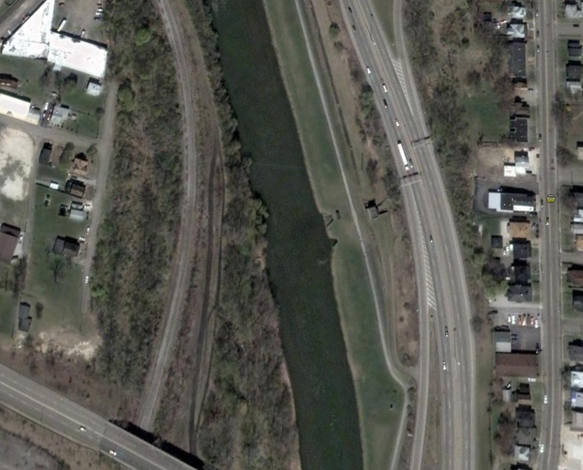
Massillon Levee Pipe Inspection Final Report February 4, 2010 By Pipeline and Drainage Consultants Subsidiary of Spartan Construction

Slide 2
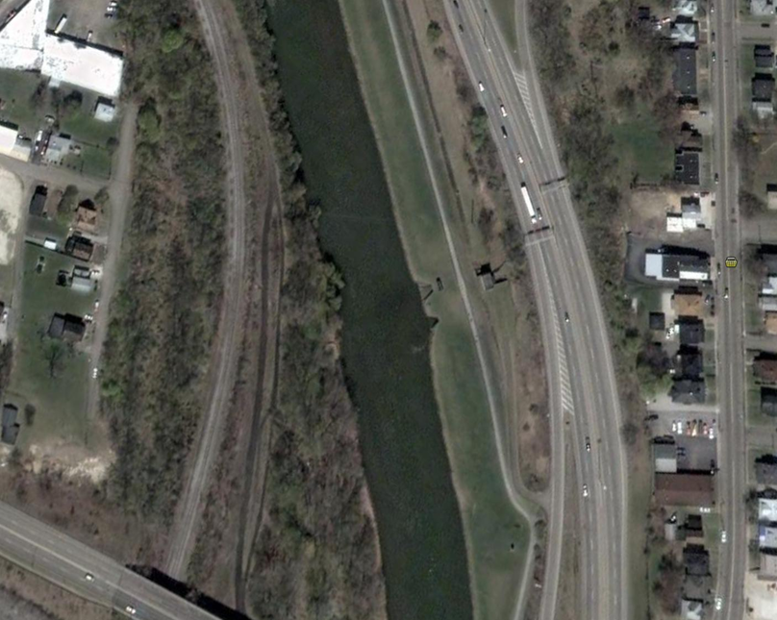
Arch Avenue Pump Station
Pump Station
Discharge Well/Outlet
Gravity Conduit Outlet

Slide 3
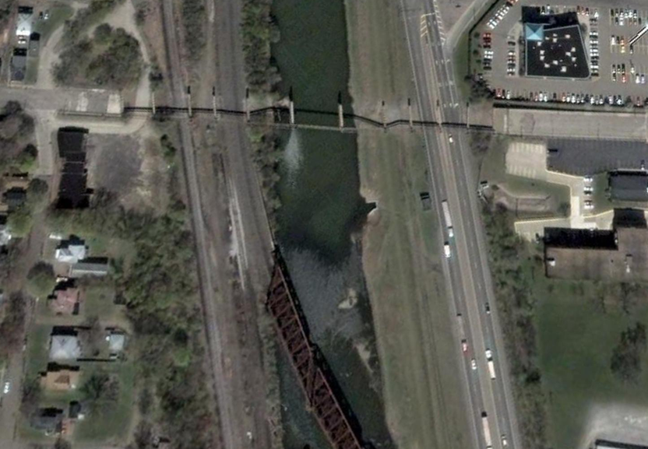
Sippo Creek Pump Station
Outlet box
Pump station
Pump station inlet

Slide 4
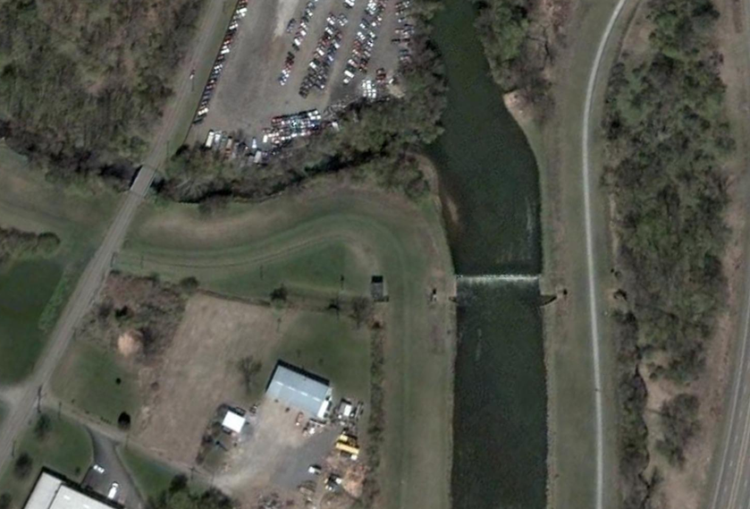
James Avenue Pump Station/ Opposite Gravity Culverts
Pump Station Discharge Well/outlet
Pipe #27 Inlet
Pump Station
Pipe #26 Gatewell/outlet
Pipe #27
Pipe # 26 inlet

Slide 5
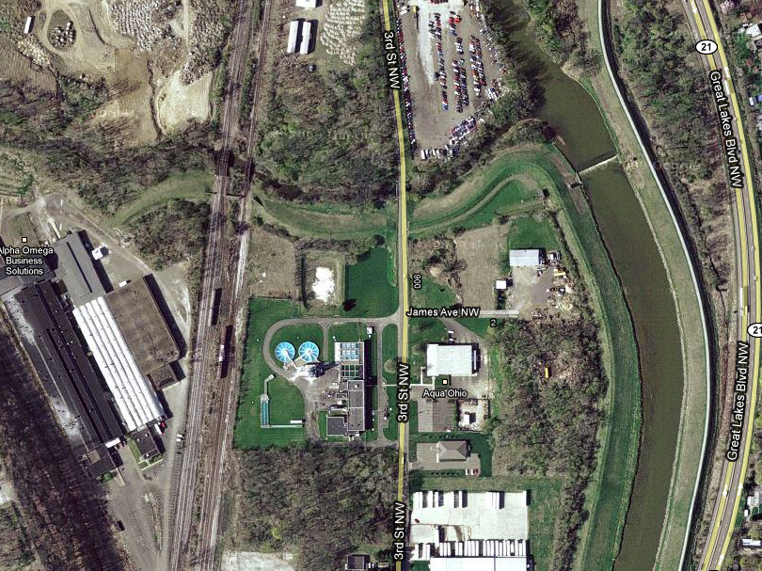
Pipe No. 23

Slide 6
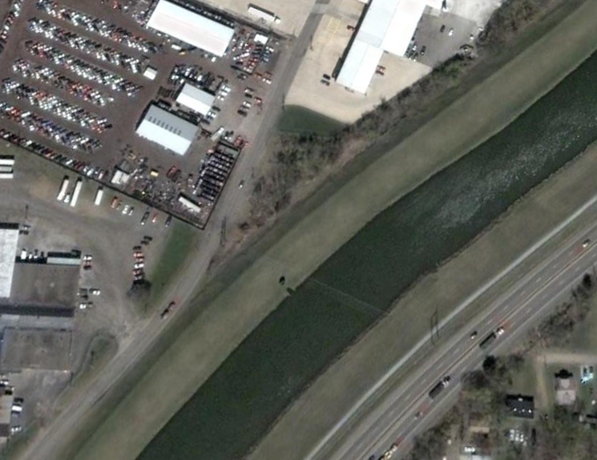
Pipe #25
On culvert thru West Bank Levee opposite Croose Avenue, 1000 ft
upstream of Cherry Road
inlet
Gatewell/outlet

Slide 7
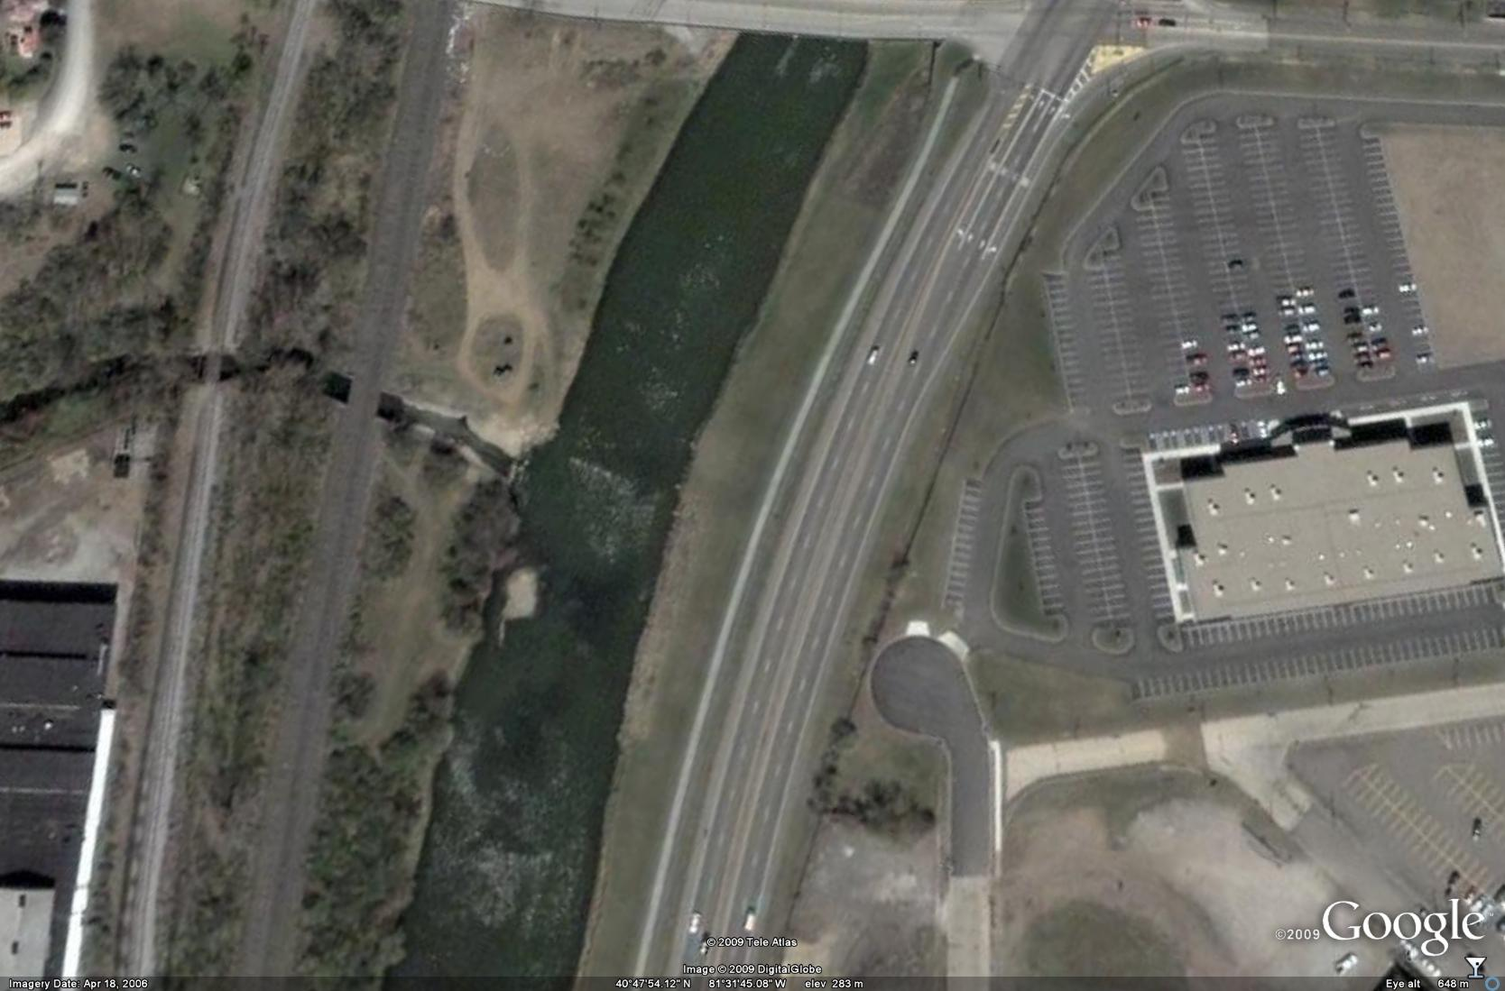
Brookfield siphon inlet
Wooster siphon inlet
Brookfield siphon outlet
Wooster siphon outlet

Slide 8
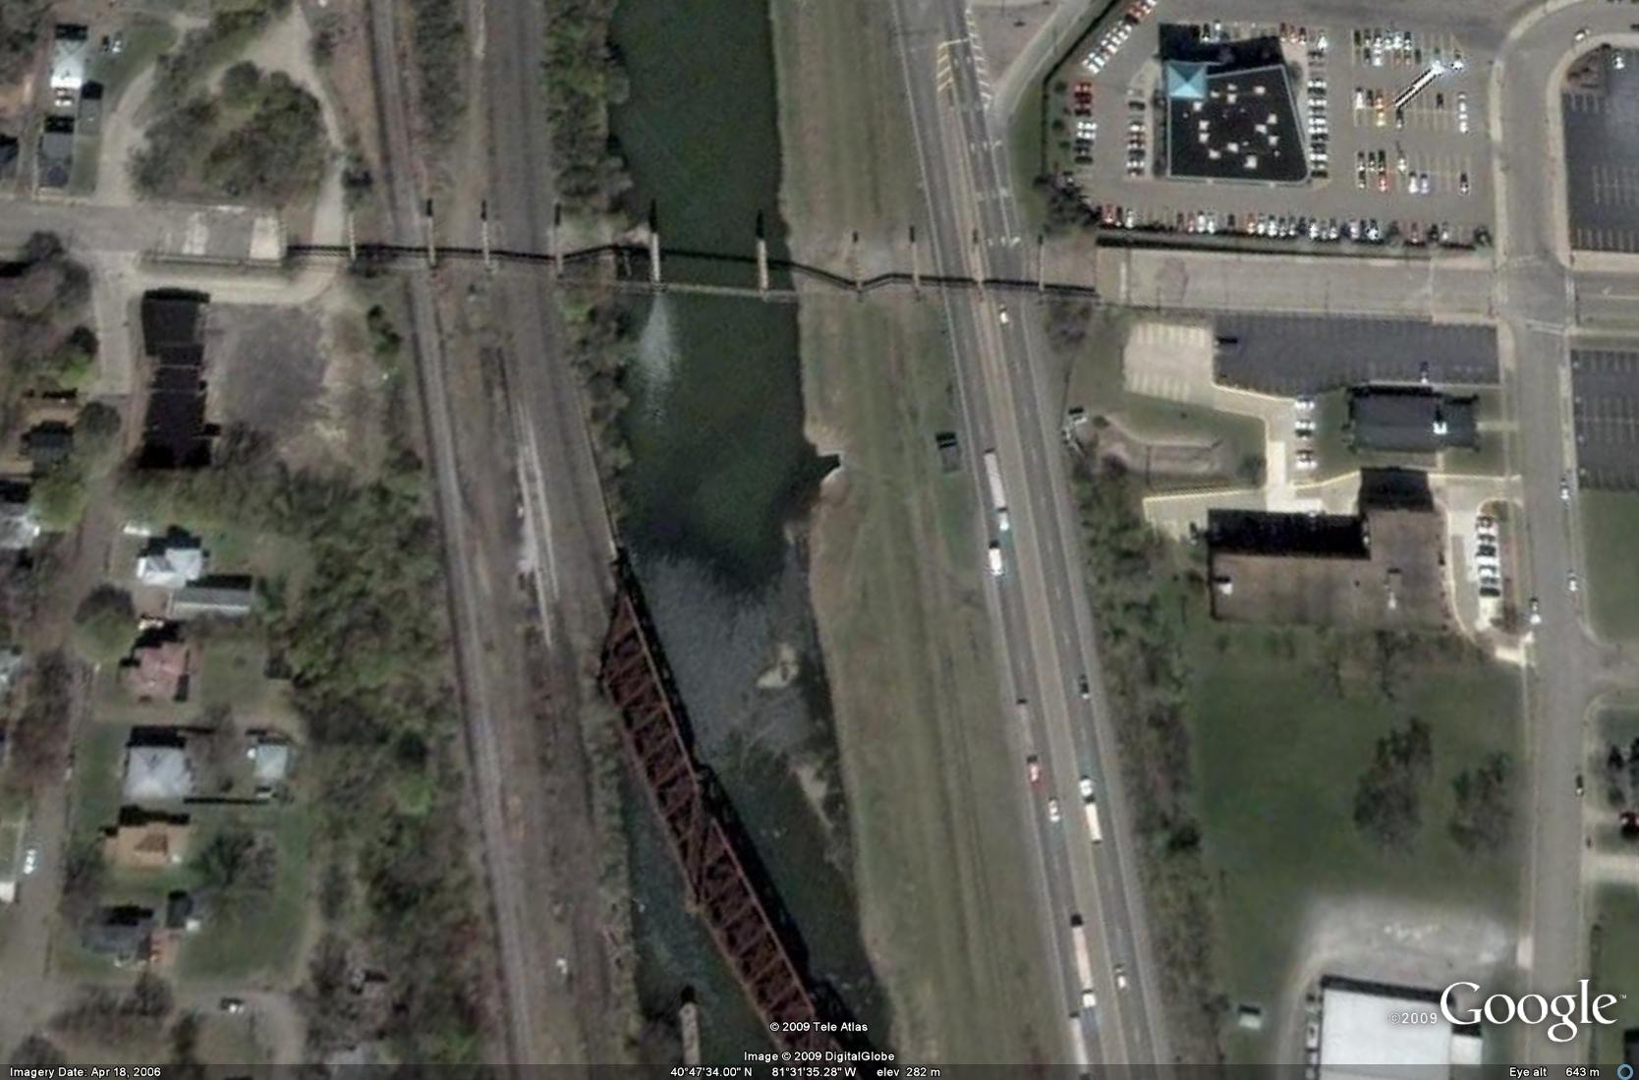
outlet
Tuscarawas Siphon
inlet

Slide 9
Pipes Inspected, Massillon Levee
Pipes | Size (Inches) | Material | Length (Feet) | Location
23 | 18 | RCP | 103 | West of RR with Flap Gate
24 | 12 | RCP? | 175 | Could not locate/unknown/does not exist
25 | 42 | RCP | 95 | Culvert through West Bank Levee opposite of Croose Avenue, 1000 ft upstream of Cherry Rd.
26 | 66 | RCP | 93 | Culvert through East Bank Levee near control weir
27 | 42 | RCP | 360 | At inlet to siphon control weir
28 | 48 | RCP | 97 | James Avenue Pump Station Gravity Outlet
29 | 30 | CIP | 100 | Discharge from James Avenue Pump Station
30 | 30 | CIP | 100 | Discharge from James Avenue Pump Station
31 | 30 | CIP | 100 | Discharge from James Avenue Pump Station
32 | 60 | RCP | 135 | Federal Avenue Pump Station Outlet
33 | 60 | RCP | 135 | Federal Avenue Pump Station Outlet
34 | 30 | CIP | 141 | Discharge from Federal Avenue Pump Station
35 | 30 | CIP | 141 | Discharge from Federal Avenue Pump Station
36 | 30 | CIP | 141 | Discharge from Federal Avenue Pump Station
37 | 15'X10' | RCP | 120 | Sippo Creek Pump Station
38 | 24 | CIP | 5 | Discharge from Sippo Creek Pump Station
39 | 24 | CIP | 10 | Discharge from Sippo Creek Pump Station
40 | 24 | CIP | 20 | Discharge from Sippo Creek Pump Station
41 | 6'X6' | RCB | 87 | Gravity Arch Avenue Pump Station
42 | 6'X6' | RCB | 87 | Gravity Arch Avenue Pump Station
43 | 24 | CIP | 85 | Discharge from Arch Avenue Pump Station
44 | 24 | CIP | 85 | Discharge from Arch Avenue Pump Station
45 | 24 | CIP | 85 | Discharge from Arch Avenue Pump Station
46 | 48 | RCP | 90 | Gravity Conduit through levee
46b | 48 | CMP | 317 | Gravity Conduit MH upstream of Levee
47 | 24 | DIP | 460 | Sanitary Siphon-Conduit-Brookfield Interceptor
48 | 14 | DIP | 460 | Sanitary Siphon-Conduit-Brookfield Interceptor
49 | 20 | DIP | 460 | Sanitary Siphon-Conduit-Brookfield Interceptor
50 | 18 | DIP | 460 | Sanitary Siphon-Conduit-Wooster Trunk
51 | 10 | DIP | 460 | Sanitary Siphon-Conduit-Wooster Trunk
52 | 15 | DIP | 460 | Sanitary Siphon-Conduit-Wooster Trunk
53 | 8 | VCP | 450 | Sanitary Siphon-Conduit-Tuscarawas River
54 | 10 | VCP | 450 | Sanitary Siphon-Conduit-Tuscarawas River

Slide 10
Army Corp of Engineers
Rating Guidelines for Levee Inspection

Slide 11
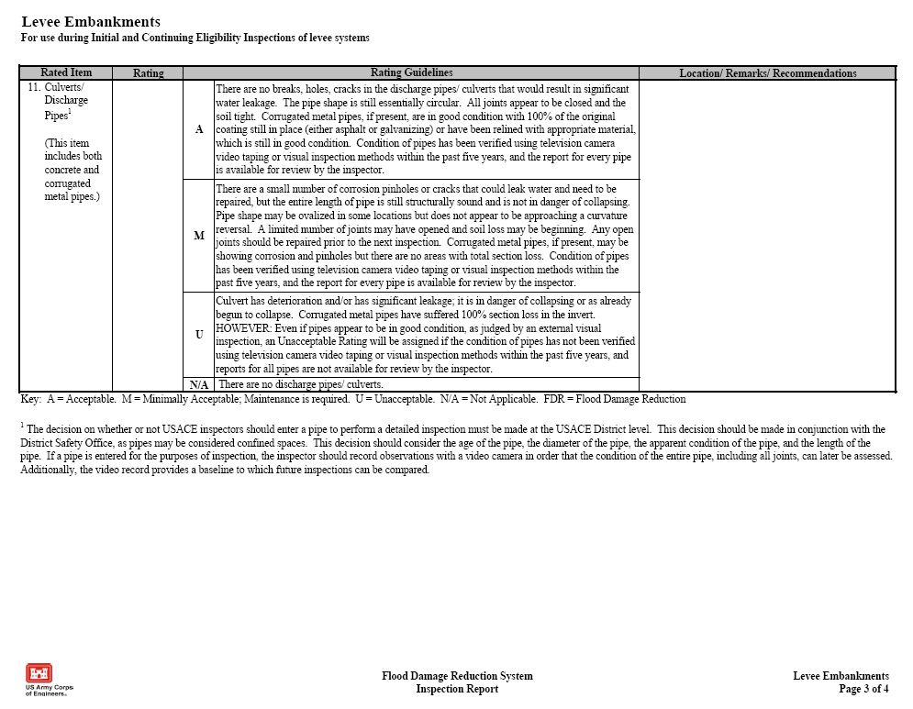

Slide 12
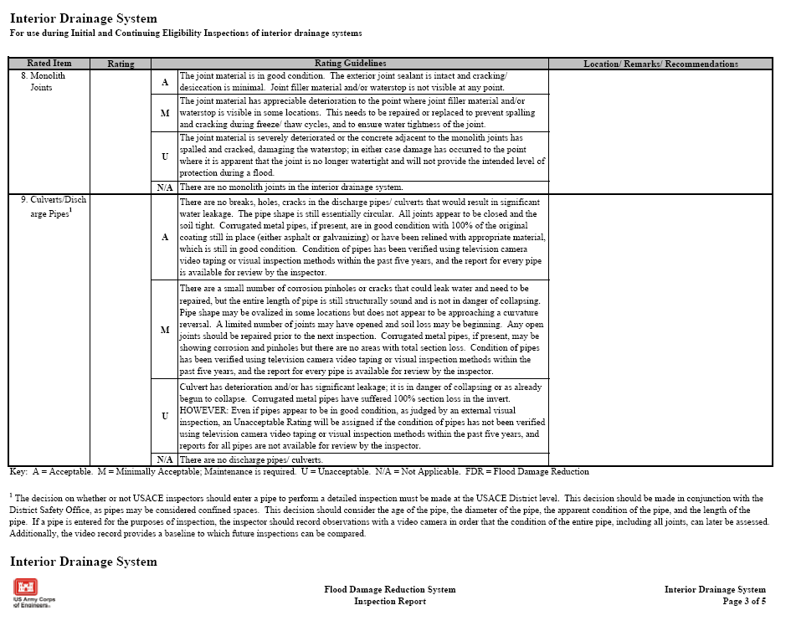

Slide 13
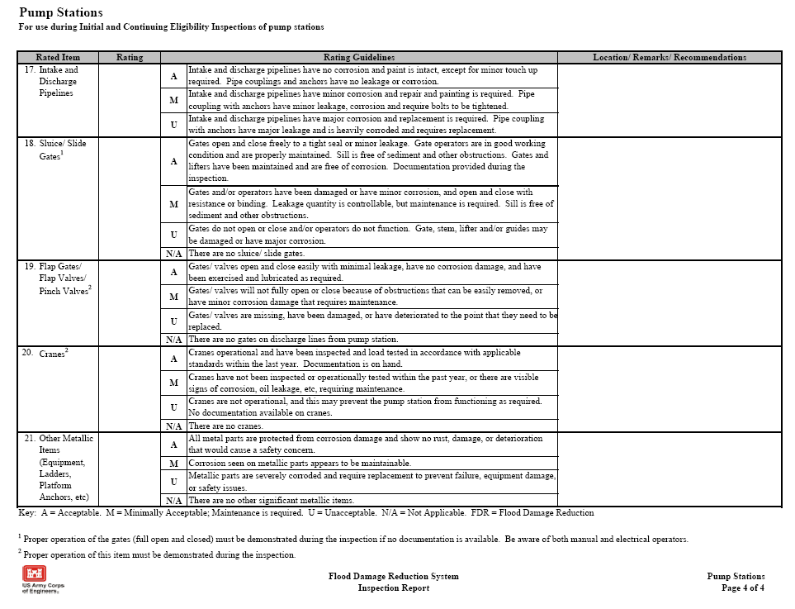

Slide 14
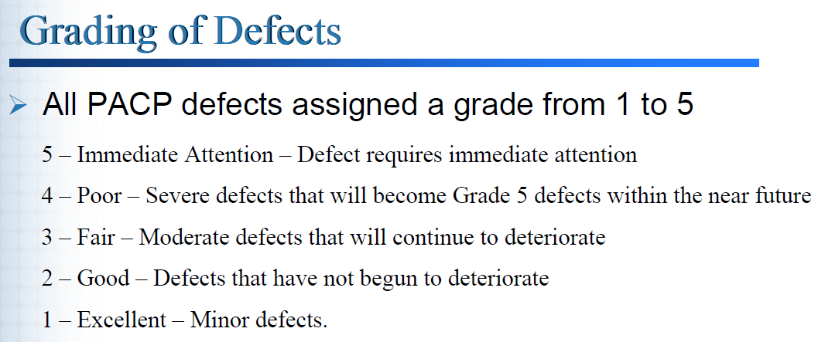
PACP Coding

Slide 15
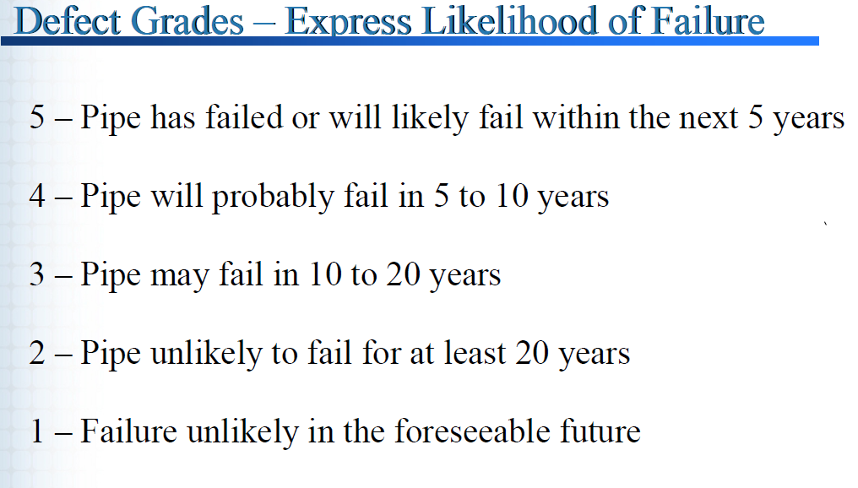
PACP Coding

Slide 16
Pipe Inspection Summary

Slide 17
Pipes Inspected, Massillon Levee
Pipes | Size (Inches) | Material | Length (Feet) |  | Location |  | Corp Rating |  | PACP Rating |  | Summary |  | Discussion/Recommedations
23 | 18 | RCP | 103 |  | West of RR with Flap Gate |  | U |  | 5 |  | Outlet manhole severely deteriorated, partially collapsed during testing, significant amount of root intrusion, several joints offset throughout the structure. |  | Manhole severely deteriorated and needs to be replaced. Roots need to be removed and pipe needs to be sealed/grouted or lined.
24 | 12 | RCP? | 175 |  | Could not locate/unknown/does not exist
25 | 42 | RCP | 95 |  | Culvert through West Bank Levee opposite of Croose Avenue, 1000 ft upstream of Cherry Rd. |  | U |  | 5 |  | Inlet was completely buried and plugged. Significant joint leakage was occurring at the third joint from the inlet. Water continued to discharge from the joint for several weeks after cleaning. |  | Consideration should be given to adding a box and drop grate near at the inlet, or grated inlet. Joint should be sealed. Water source infiltrating into the structure should be located.
26 | 66 | RCP | 93 |  | Culvert through East Bank Levee near control weir |  | M |  | 5 |  | Several joints offset throughout the structure, several joints broken, moisture present at several joints, pipe possibly starting show distress from water moving outside the structure. |  | Pipe joint should be sealed, damaged joint should be repaired. Structure may need to be lined.
27 | 42 | DIP to RCP | 360 |  | At inlet to siphon control weir |  | U |  | 5 |  | DIP moderately corroded, several stained and leaking joints in RCP pipe. Heavy flow from joint at 173 feet. Radial and diagonal cracking noted in several areas along upstream side of the structure. |  | Manual entry was limited due to low oxygen levels in the pipe at the time of the inspection, unsure on voids at joints, Inlet grate severely corroded, no coating on the DIP, several stained in RCP. Inlet grate should be repaired, DIP should be recoated, and the joints in the RCP should be patched and sealed. Soundings should be conducted in areas of high infiltration.
28 | 48 | RCP | 97 |  | James Avenue Pump Station Gravity Outlet |  | M |  | 4 |  | Sagging visible from inlet to gatewell, joint more open on bottom, several joint weeping water. |  | Pipe joints should be sealed.
29 | 30 | CIP | 100 |  | Discharge from James Avenue Pump Station |  | M |  | 4 |  | All three pipes have moderate to severe corrosion at the joints. Missing protective coating was missing not only at the joints but in flat areas and sharp bends. It appears that point repairs of the protective coating have been made in sections. |  | Recommend air pressure testing to verify the integrity of the joints, areas of missing protective coating should be repaired prior to additional degradation.
30 | 30 | CIP | 100 |  | Discharge from James Avenue Pump Station |  | M |  | 4
31 | 30 | CIP | 100 |  | Discharge from James Avenue Pump Station |  | M |  | 4

Slide 18
Pipes | Size (Inches) | Material | Length (Feet) | Location | Corp Rating | PACP Rating | Summary | Discussion/Recommedations
32 | 60 | RCP | 135 | Federal Avenue Pump Station Outlet | A-M | 3 to 4 | 0-42 feet CMP, CMP bituminous coating missing in haunches, moderate corrosion, RCP 42 to gatewell appears to be in good condition, moisture present at some of the joints. | The CMP is starting to show signs of moderate to significant corrosion in areas, most of the paved invert is missing.
33 | 60 | RCP | 135 | Federal Avenue Pump Station Outlet | A-M | 3 to 4 | 0-42 feet CMP, CMP bituminous coating missing in haunches, moderate corrosion, RCP 42 to gatewell appears to be in good condition, moisture present at some of the joints.
34 | 30 | CIP | 141 | Discharge from Federal Avenue Pump Station | M | 4 | All three pipes have moderate to severe corrosion at the joints, missing protective coating also noted in flat areas and bends. It appears in some sections point repairs have been made on the protective coating. | Recommend air pressure testing to verify the integrity of the joints, areas of missing protective coating should be repaired prior to additional degradation.
35 | 30 | CIP | 141 | Discharge from Federal Avenue Pump Station | M | 4
36 | 30 | CIP | 141 | Discharge from Federal Avenue Pump Station | M | 4
37 | 15'X10' | RCB | 120 | Sippo Creek Pump Station | M | 3 to 4 | Most of the joints appear to have some weeping and/or signs of staining at the joints. Invert is rough in areas indicating moderate scouring. Rebar exposed and some spalling noticed in areas. | Recommend that the joints be repaired and sealed.
38 | 24 | CIP | 5 | Discharge from Sippo Creek Pump Station | M | 4 | All three pipes have moderate to severe corrosion at the joints, missing protective coating also noted in the inverts and haunches of the pipes. Pipe #39 has a severe offset joint with potential leakage. | Recommend air pressure testing to verify the integrity of the joints, areas of missing protective coating should be repaired prior to additional degradation.
39 | 24 | CIP | 10 | Discharge from Sippo Creek Pump Station | M | 4
40 | 24 | CIP | 20 | Discharge from Sippo Creek Pump Station | M | 4

Slide 19
Pipes | Size (Inches) | Material | Length (Feet) | Location | Corp Rating | PACP Rating | Summary | Discussion/Recommedations
41 | 6'X6' | RCB | 87 | Gravity Arch Avenue Pump Station | M | 3 to 4 | Offset joint in crown of box at 23 ft, spalling in crown near gatewell, last section of pipe at (80 ft) outlet is offset and leaking, signs of potential soil movement. | All joints should be cleaned, resealed, and repaired if need. Offset joints should be evaluated for potential voids and pressure grouted if necessary.
42 | 6'X6' | RCB | 87 | Gravity Arch Avenue Pump Station | M | 3 to 4 | Water movement at entrance in crown and headwall, open joints between barrels, moisture present in some of the joints, offset joint in box at gatewell, last section of pipe at outlet is offset and leaking, signs of potential soil movement. | All joints should be cleaned, resealed, and repaired if need. Offset joints should be evaluated for potential voids and pressure grouted if necessary.
43 | 24 | CIP | 85 | Discharge from Arch Avenue Pump Station | M | 4 | All three pipes have moderate to severe corrosion at the joints, missing protective coating also noted in the flat areas and flat bends. | Recommend air pressure testing to verify the integrity of the joints, areas of missing protective coating should be repaired prior to additional degradation.
44 | 24 | CIP | 85 | Discharge from Arch Avenue Pump Station | M | 4
45 | 24 | CIP | 85 | Discharge from Arch Avenue Pump Station | M | 4
46 | 48 | RCP | 90 | Gravity Conduit through levee | A-M | 3 | Pipe is showing some signs of settlement could be due to movement of water under neath the structure caused by the up gradient CMP structure. | The CMP upstream line should be replaced or lined. Concern is that settlement is noticeable in the down stream line under the levee. Unsure if water moving outside the CMP may be flowing around the manhole and under the downstream structure potential causing the observed settlement.
46b | 48 | CMP | 317 | Gravity Conduit MH upstream of Levee | U | 5 | CMP structure is severely corroded, invert missing, pipe starting to deflect. Unsure how much water is moving outside/under the structure.
47 | 24 | DIP | 460 | Siphon-Conduit-Brookfield Interceptor | A-M | 3 | Minor corrosion at the joints, protective coating coming off in sheets in several areas. No gate valves/cut off valves were installed on the system. | All three pipes are showing minor to moderate loss of the protective coating, material coming off in sheets. System design did not allow for Sonar or entire pipe to be camera inspected. It is anticipated that additional heavy cleaning would degrade the life of the pipe through removal of the protective coating.
48 | 14 | DIP | 460 | Siphon-Conduit-Brookfield Interceptor | A-M | 3
49 | 20 | DIP | 460 | Siphon-Conduit-Brookfield Interceptor | A-M | 3
50 | 18 | DIP | 460 | Siphon-Conduit-Wooster Trunk | M-U | 4 | Gate valves for Pipe No. 51 and 52 were frozen mid position, Gate valve for No. 50 difficult to turn. Pipe 51 and 52 could not be inspected. Pipe not 50 was severely corroded above the waterline. | Due to the limited inspection and the poor condition of the pipe that was inspected, and the difficulties of maintaining and inspecting the siphons consideration of replacing the siphon with a pump station should be weighed vs repairing several of the siphons.
51 | 10 | DIP | 460 | Siphon-Conduit-Wooster Trunk | M-U | 4
52 | 15 | DIP | 460 | Siphon-Conduit-Wooster Trunk | M-U | 4
53 | 8 | VCP | 450 | Siphon-Conduit-Tuscarawas River | M-U | 5 | Gate valves were broken on both pipes, diversion board on inlet was rotted through. Metal pipe at gate valves severely corroded. Significant offset/and or debris build up at outlet of Pipe 53, several offset joints in Pipe No. 54. | Due to the limited inspection and the poor condition of the pipe that was inspected, and the difficulties of maintaining and inspecting the siphons consideration of replacing the siphons with a pump station should be weighed vs repairing several of the siphons.
54 | 10 | VCP | 450 | Siphon-Conduit-Tuscarawas River | M-U | 4

Slide 20
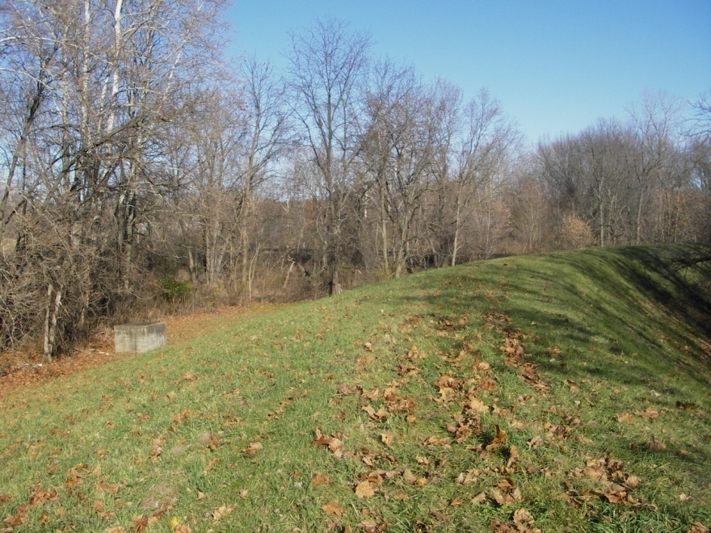
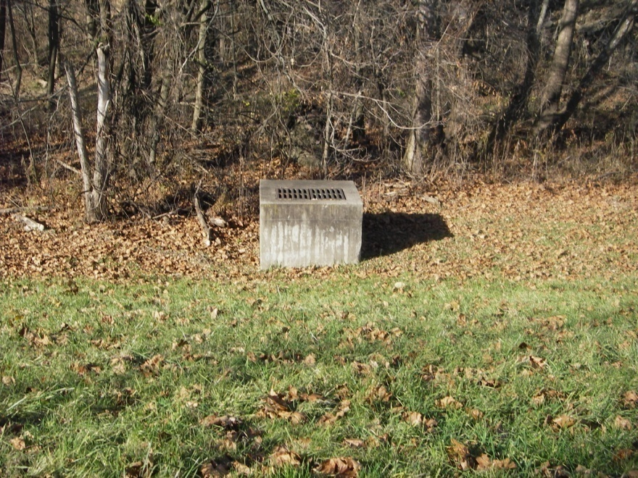
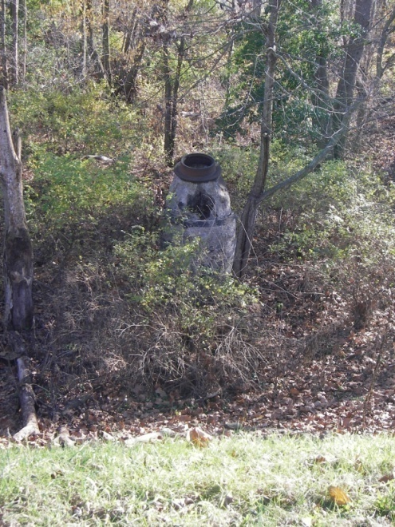
Pipe No. 23 18-Inch Storm Drain

Slide 21
Pipes Inspected, Massillon Levee
Pipes | Size (Inches) | Material | Length (Feet) | Location
23 | 18 | RCP | 103 | West of RR with Flap Gate
24 | 12 | RCP? | 175 | Could not locate/unknown/does not exist
25 | 42 | RCP | 95 | Culvert through West Bank Levee opposite of Croose Avenue
26 | 66 | RCP | 93 | Culvert through East Bank Levee near control weir
27 | 42 | RCP | 360 | At inlet to siphon control weir
28 | 48 | RCP | 97 | James Avenue Pump Station Gravity Outlet
29 | 30 | CIP | 100 | Discharge from James Avenue Pump Station
30 | 30 | CIP | 100 | Discharge from James Avenue Pump Station
31 | 30 | CIP | 100 | Discharge from James Avenue Pump Station
32 | 60 | RCP | 135 | Federal Avenue Pump Station Outlet
33 | 60 | RCP | 135 | Federal Avenue Pump Station Outlet
34 | 30 | CIP | 141 | Discharge from Federal Avenue Pump Station
35 | 30 | CIP | 141 | Discharge from Federal Avenue Pump Station
36 | 30 | CIP | 141 | Discharge from Federal Avenue Pump Station
37 | 15'X10' | RCP | 120 | Sippo Avenue Pump Station
38 | 24 | CIP | 5 | Discharge from Sippo Avenue Pump Station
39 | 24 | CIP | 10 | Discharge from Sippo Avenue Pump Station
40 | 24 | CIP | 20 | Discharge from Sippo Avenue Pump Station
41 | 6'X6' | RCB | 87 | Gravity Arch Avenue Pump Station
42 | 6'X6' | RCB | 87 | Gravity Arch Avenue Pump Station
43 | 24 | CIP | 85 | Discharge from Arch Avenue Pump Station
44 | 24 | CIP | 85 | Discharge from Arch Avenue Pump Station
45 | 24 | CIP | 85 | Discharge from Arch Avenue Pump Station
46 | 48 | RCP | 90 | Gravity Conduit through levee
46b | 48 | CMP | 317 | Gravity Conduit MH upstream of Levee
47 | 24 | DIP | 460 | Siphon-Conduit-Brookfield Interceptor
48 | 14 | DIP | 460 | Siphon-Conduit-Brookfield Interceptor
49 | 20 | DIP | 460 | Siphon-Conduit-Brookfield Interceptor
50 | 18 | DIP | 460 | Siphon-Conduit-Wooster Trunk
51 | 10 | DIP | 460 | Siphon-Conduit-Wooster Trunk
52 | 15 | DIP | 460 | Siphon-Conduit-Wooster Trunk
53 | 8 | VCP | 450 | Siphon-Conduit-Tuscarawas River
54 | 10 | VCP | 450 | Siphon-Conduit-Tuscarawas River

Slide 22
Pipe No. 23

Slide 23

Levee at pipe #23

Slide 24
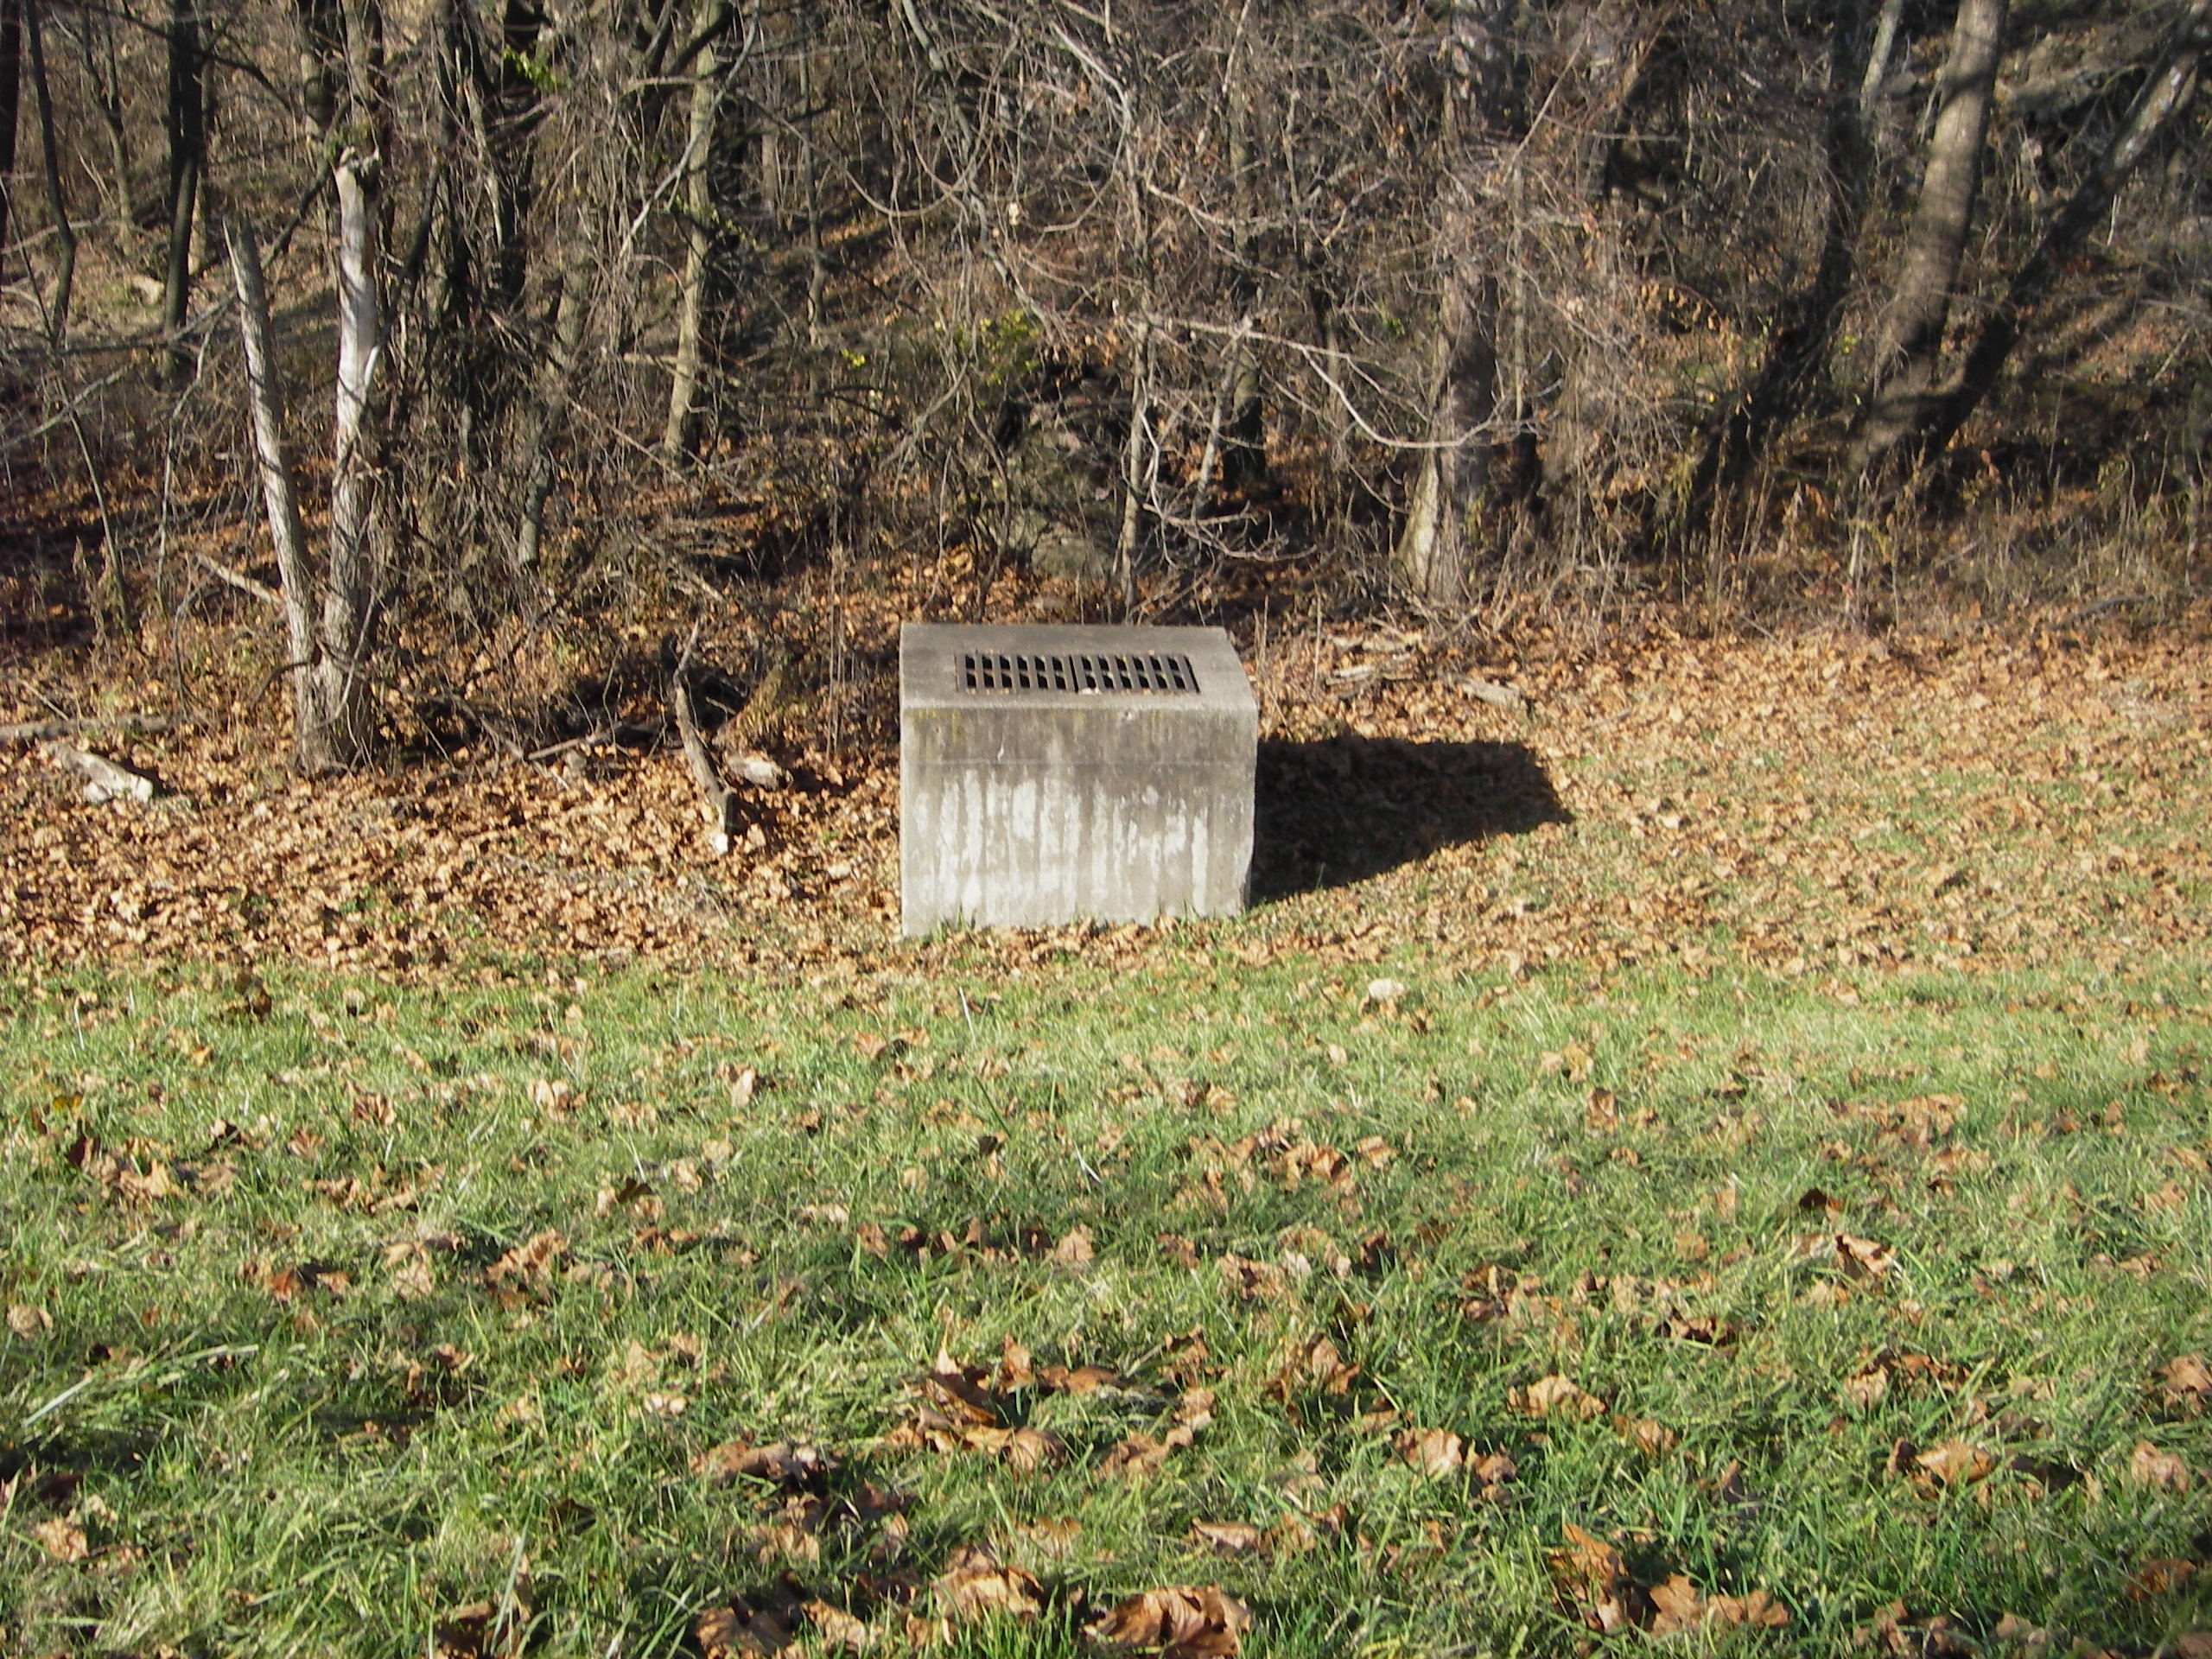
Pipe #23 out

Slide 25
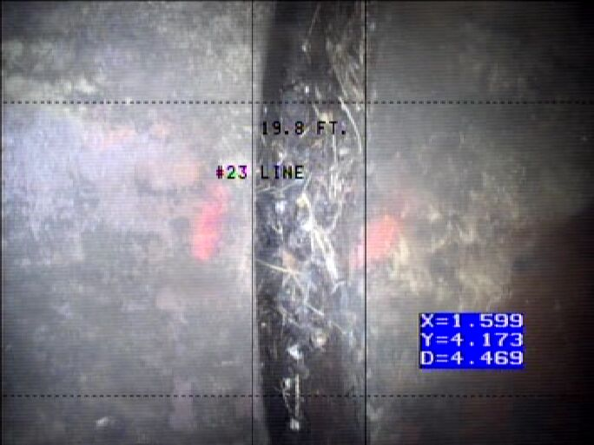
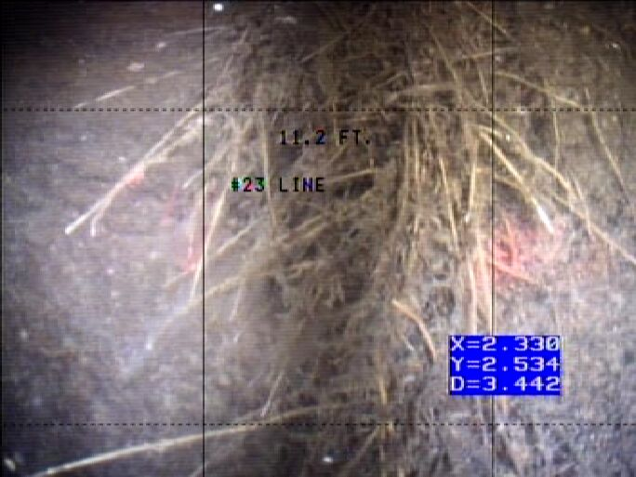
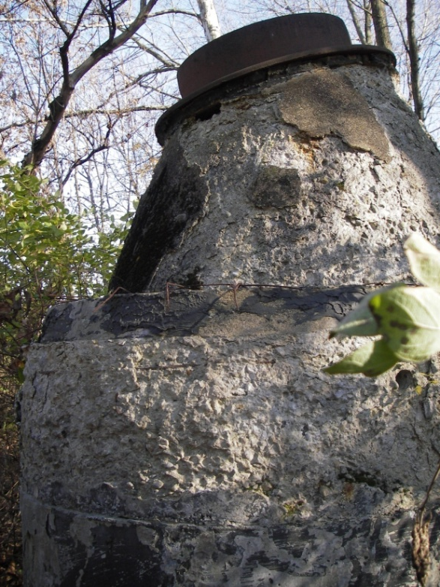

Slide 27
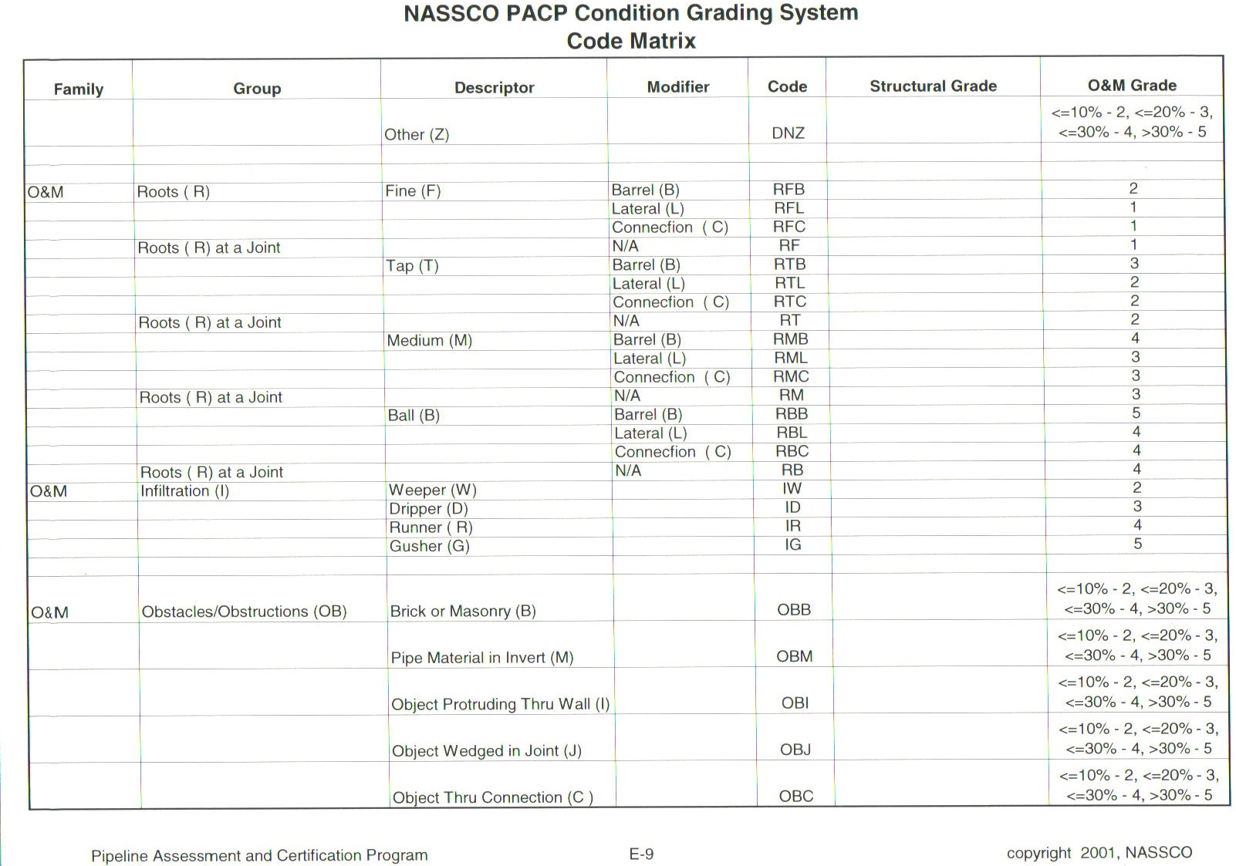

Slide 28
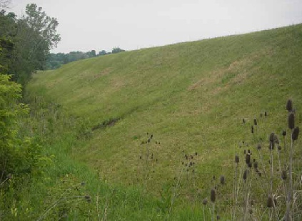
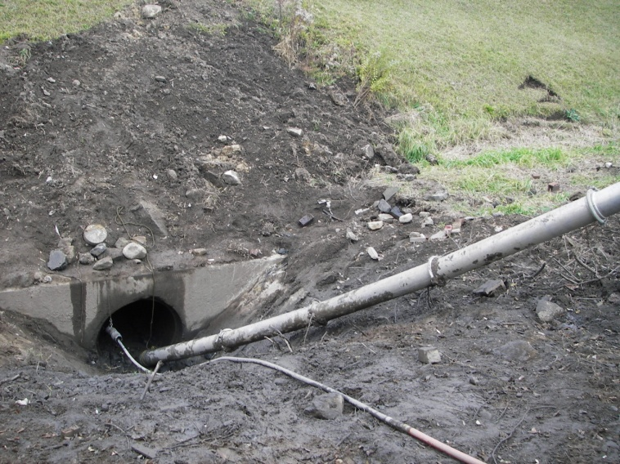
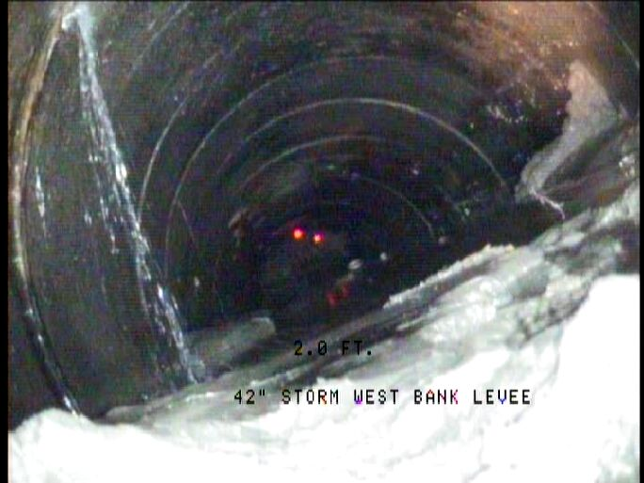
Pipe No. 25 42-Inch RCP Storm Drain

Slide 29
Pipes Inspected, Massillon Levee
Pipes | Size (Inches) | Material | Length (Feet) | Location
23 | 18 | RCP | 103 | West of RR with Flap Gate
24 | 12 | RCP? | 175 | Could not locate/unknown/does not exist
25 | 42 | RCP | 95 | Culvert through West Bank Levee opposite of Croose Avenue
26 | 66 | RCP | 93 | Culvert through East Bank Levee near control weir
27 | 42 | RCP | 360 | At inlet to siphon control weir
28 | 48 | RCP | 97 | James Avenue Pump Station Gravity Outlet
29 | 30 | CIP | 100 | Discharge from James Avenue Pump Station
30 | 30 | CIP | 100 | Discharge from James Avenue Pump Station
31 | 30 | CIP | 100 | Discharge from James Avenue Pump Station
32 | 60 | RCP | 135 | Federal Avenue Pump Station Outlet
33 | 60 | RCP | 135 | Federal Avenue Pump Station Outlet
34 | 30 | CIP | 141 | Discharge from Federal Avenue Pump Station
35 | 30 | CIP | 141 | Discharge from Federal Avenue Pump Station
36 | 30 | CIP | 141 | Discharge from Federal Avenue Pump Station
37 | 15'X10' | RCB | 120 | Sippo Creek Pump Station
38 | 24 | CIP | 5 | Discharge from Sippo Creek Pump Station
39 | 24 | CIP | 10 | Discharge from Sippo Creek Pump Station
40 | 24 | CIP | 20 | Discharge from Sippo Creek Pump Station
41 | 6'X6' | RCB | 87 | Gravity Arch Avenue Pump Station
42 | 6'X6' | RCB | 87 | Gravity Arch Avenue Pump Station
43 | 24 | CIP | 85 | Discharge from Arch Avenue Pump Station
44 | 24 | CIP | 85 | Discharge from Arch Avenue Pump Station
45 | 24 | CIP | 85 | Discharge from Arch Avenue Pump Station
46 | 48 | RCP | 90 | Gravity Conduit through levee
46b | 48 | CMP | 317 | Gravity Conduit MH upstream of Levee
47 | 24 | DIP | 460 | Siphon-Conduit-Brookfield Interceptor
48 | 14 | DIP | 460 | Siphon-Conduit-Brookfield Interceptor
49 | 20 | DIP | 460 | Siphon-Conduit-Brookfield Interceptor
50 | 18 | DIP | 460 | Siphon-Conduit-Wooster Trunk
51 | 10 | DIP | 460 | Siphon-Conduit-Wooster Trunk
52 | 15 | DIP | 460 | Siphon-Conduit-Wooster Trunk
53 | 8 | VCP | 450 | Siphon-Conduit-Tuscarawas River
54 | 10 | VCP | 450 | Siphon-Conduit-Tuscarawas River

Slide 30
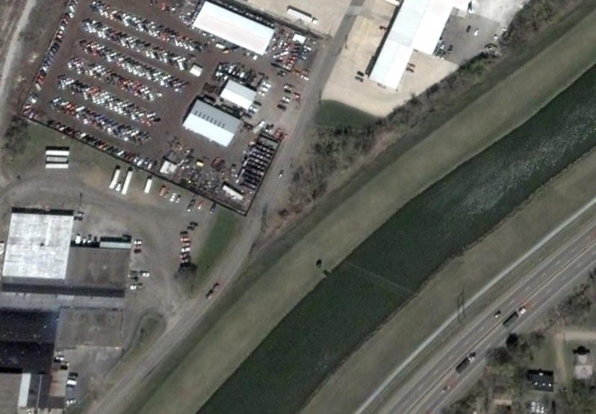
Pipe #25
inlet
outlet

Slide 31
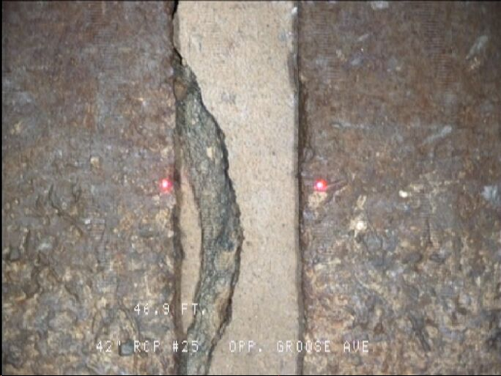
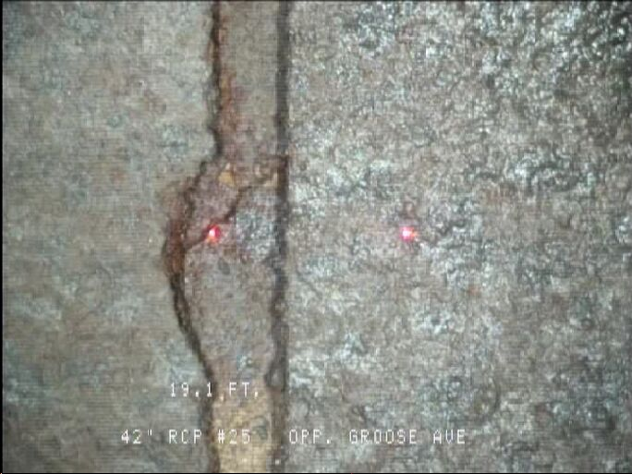

Slide 34
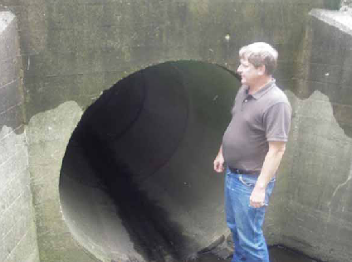
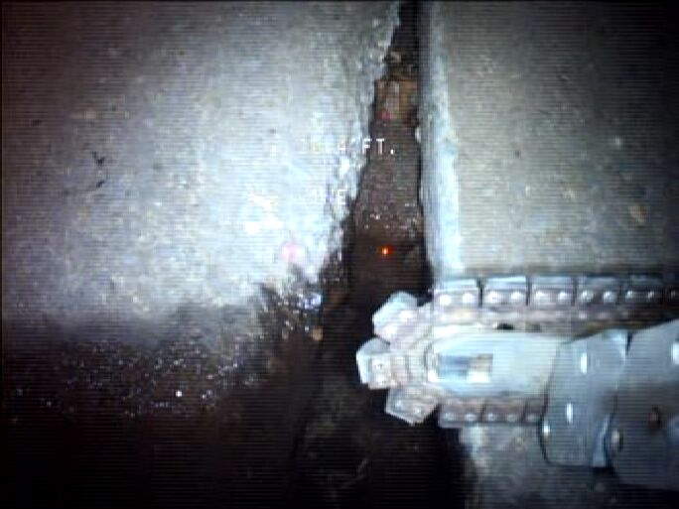
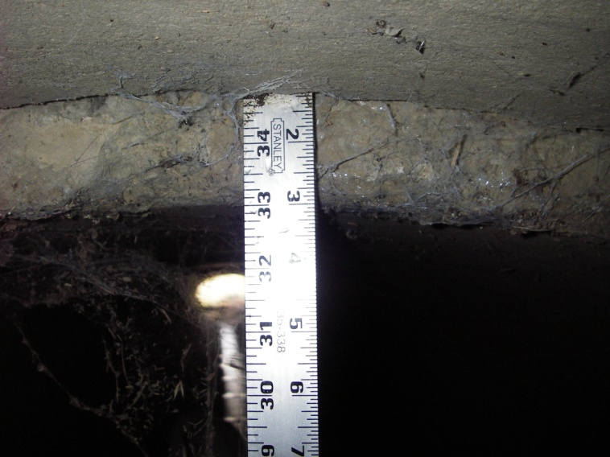
Pipe No. 26 66-Inch RCP Storm Drain

Slide 35
Pipes Inspected, Massillon Levee
Pipes | Size (Inches) | Material | Length (Feet) | Location
23 | 18 | RCP | 103 | West of RR with Flap Gate
24 | 12 | RCP? | 175 | Could not locate/unknown/does not exist
25 | 42 | RCP | 95 | Culvert through West Bank Levee opposite of Croose Avenue
26 | 66 | RCP | 93 | Culvert through East Bank Levee near control weir
27 | 42 | RCP | 360 | At inlet to siphon control weir
28 | 48 | RCP | 97 | James Avenue Pump Station Gravity Outlet
29 | 30 | CIP | 100 | Discharge from James Avenue Pump Station
30 | 30 | CIP | 100 | Discharge from James Avenue Pump Station
31 | 30 | CIP | 100 | Discharge from James Avenue Pump Station
32 | 60 | RCP | 135 | Federal Avenue Pump Station Outlet
33 | 60 | RCP | 135 | Federal Avenue Pump Station Outlet
34 | 30 | CIP | 141 | Discharge from Federal Avenue Pump Station
35 | 30 | CIP | 141 | Discharge from Federal Avenue Pump Station
36 | 30 | CIP | 141 | Discharge from Federal Avenue Pump Station
37 | 15'X10' | RCB | 120 | Sippo Creek Pump Station
38 | 24 | CIP | 5 | Discharge from Sippo Creek Pump Station
39 | 24 | CIP | 10 | Discharge from Sippo Creek Pump Station
40 | 24 | CIP | 20 | Discharge from Sippo Creek Pump Station
41 | 6'X6' | RCB | 87 | Gravity Arch Avenue Pump Station
42 | 6'X6' | RCB | 87 | Gravity Arch Avenue Pump Station
43 | 24 | CIP | 85 | Discharge from Arch Avenue Pump Station
44 | 24 | CIP | 85 | Discharge from Arch Avenue Pump Station
45 | 24 | CIP | 85 | Discharge from Arch Avenue Pump Station
46 | 48 | RCP | 90 | Gravity Conduit through levee
46b | 48 | CMP | 317 | Gravity Conduit MH upstream of Levee
47 | 24 | DIP | 460 | Siphon-Conduit-Brookfield Interceptor
48 | 14 | DIP | 460 | Siphon-Conduit-Brookfield Interceptor
49 | 20 | DIP | 460 | Siphon-Conduit-Brookfield Interceptor
50 | 18 | DIP | 460 | Siphon-Conduit-Wooster Trunk
51 | 10 | DIP | 460 | Siphon-Conduit-Wooster Trunk
52 | 15 | DIP | 460 | Siphon-Conduit-Wooster Trunk
53 | 8 | VCP | 450 | Siphon-Conduit-Tuscarawas River
54 | 10 | VCP | 450 | Siphon-Conduit-Tuscarawas River

Slide 36
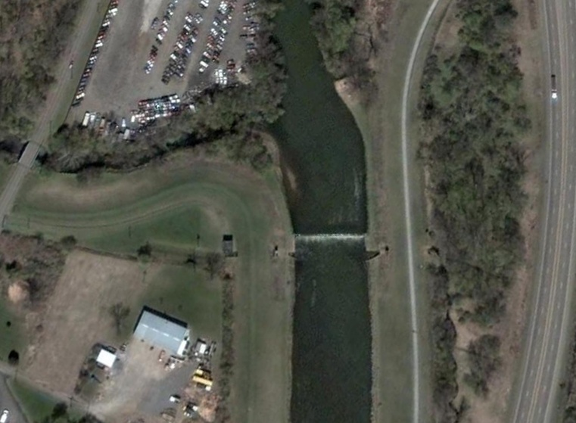
Pipe #26 outlet
James Avenue Pump station
Pipe # 26 inlet
Pipe No. 26. Culvert through East Bank Levee near control weir

Slide 37
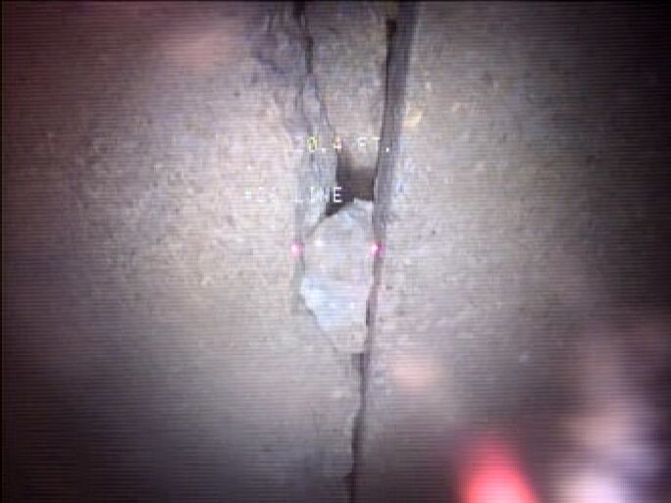

Slide 39
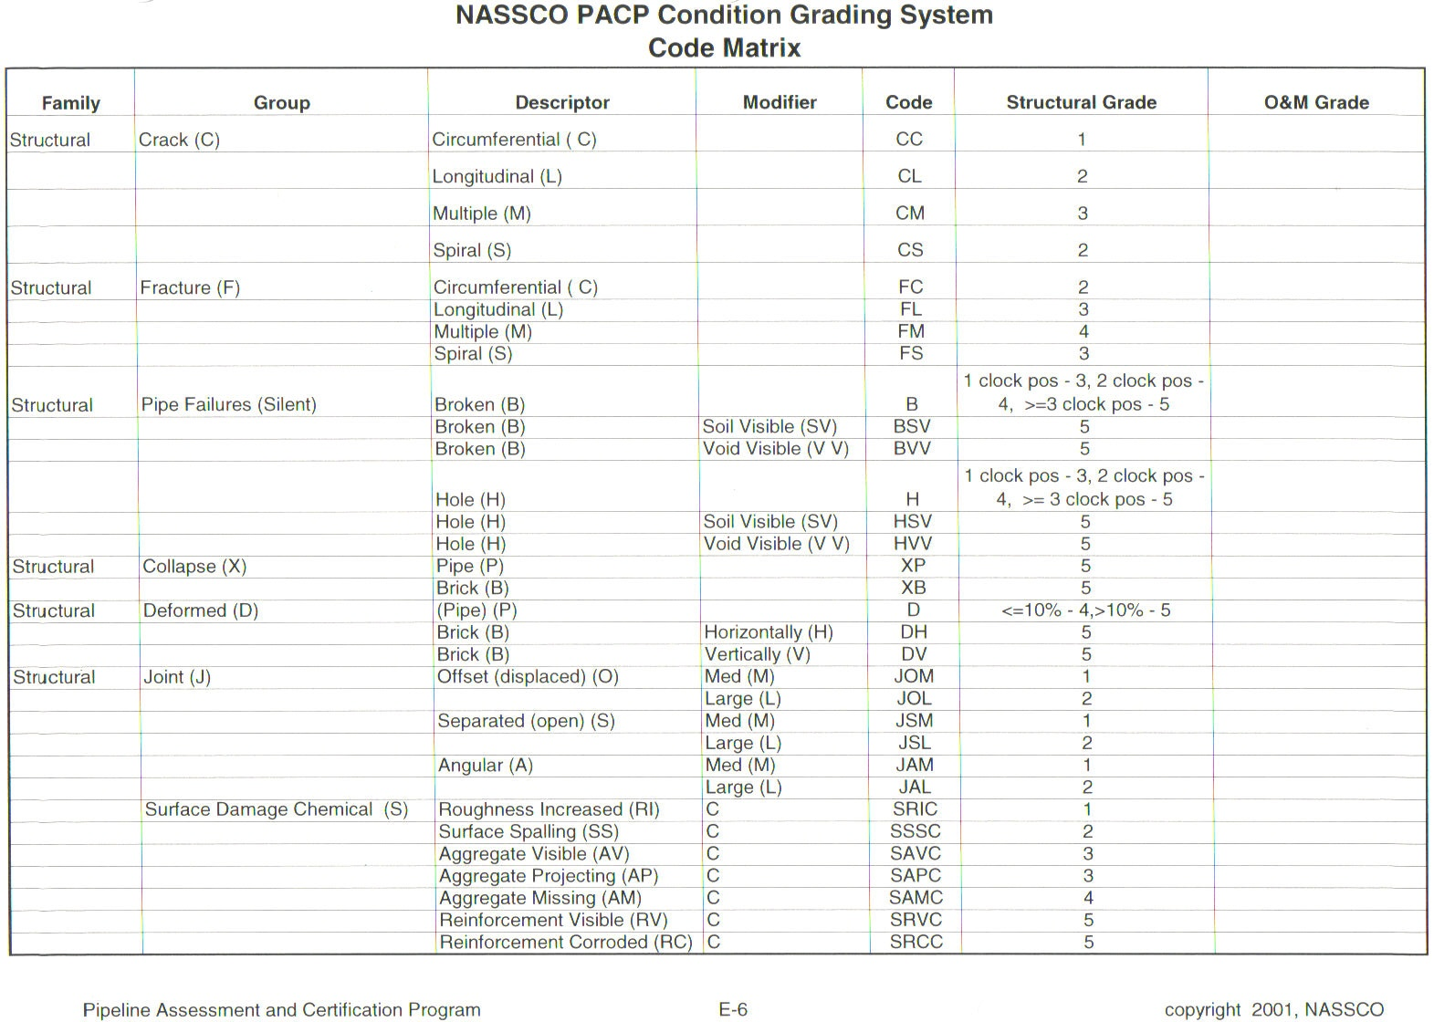

Slide 40
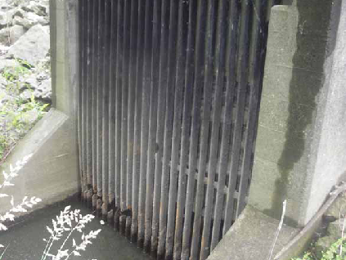
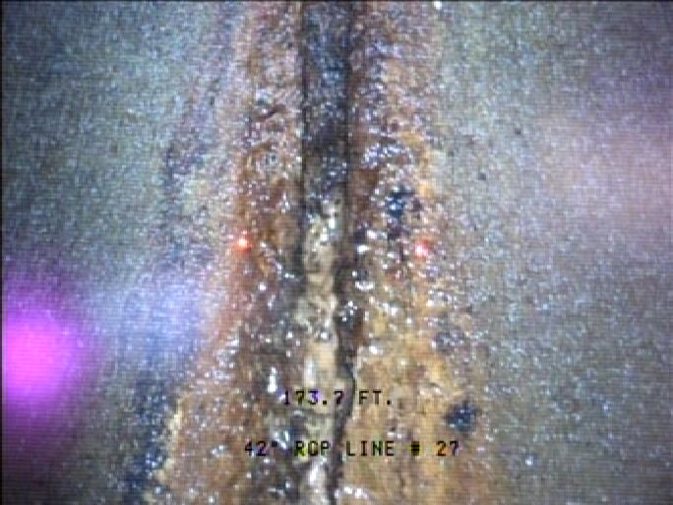
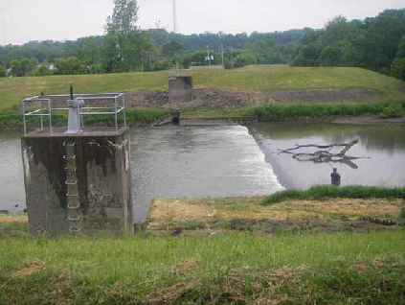
Pipe No. 27 42-Inch RCP Storm Drain/Siphon

Slide 41
Pipes Inspected, Massillon Levee
Pipes | Size (Inches) | Material | Length (Feet) | Location
23 | 18 | RCP | 103 | West of RR with Flap Gate
24 | 12 | RCP? | 175 | Could not locate/unknown/does not exist
25 | 42 | RCP | 95 | Culvert through West Bank Levee opposite of Croose Avenue
26 | 66 | RCP | 93 | Culvert through East Bank Levee near control weir
27 | 42 | RCP | 360 | At inlet to siphon control weir
28 | 48 | RCP | 97 | James Avenue Pump Station Gravity Outlet
29 | 30 | CIP | 100 | Discharge from James Avenue Pump Station
30 | 30 | CIP | 100 | Discharge from James Avenue Pump Station
31 | 30 | CIP | 100 | Discharge from James Avenue Pump Station
32 | 60 | RCP | 135 | Federal Avenue Pump Station Outlet
33 | 60 | RCP | 135 | Federal Avenue Pump Station Outlet
34 | 30 | CIP | 141 | Discharge from Federal Avenue Pump Station
35 | 30 | CIP | 141 | Discharge from Federal Avenue Pump Station
36 | 30 | CIP | 141 | Discharge from Federal Avenue Pump Station
37 | 15'X10' | RCB | 120 | Sippo Creek Pump Station
38 | 24 | CIP | 5 | Discharge from Sippo Creek Pump Station
39 | 24 | CIP | 10 | Discharge from Sippo Creek Pump Station
40 | 24 | CIP | 20 | Discharge from Sippo Creek Pump Station
41 | 6'X6' | RCB | 87 | Gravity Arch Avenue Pump Station
42 | 6'X6' | RCB | 87 | Gravity Arch Avenue Pump Station
43 | 24 | CIP | 85 | Discharge from Arch Avenue Pump Station
44 | 24 | CIP | 85 | Discharge from Arch Avenue Pump Station
45 | 24 | CIP | 85 | Discharge from Arch Avenue Pump Station
46 | 48 | RCP | 90 | Gravity Conduit through levee
46b | 48 | CMP | 317 | Gravity Conduit MH upstream of Levee
47 | 24 | DIP | 460 | Siphon-Conduit-Brookfield Interceptor
48 | 14 | DIP | 460 | Siphon-Conduit-Brookfield Interceptor
49 | 20 | DIP | 460 | Siphon-Conduit-Brookfield Interceptor
50 | 18 | DIP | 460 | Siphon-Conduit-Wooster Trunk
51 | 10 | DIP | 460 | Siphon-Conduit-Wooster Trunk
52 | 15 | DIP | 460 | Siphon-Conduit-Wooster Trunk
53 | 8 | VCP | 450 | Siphon-Conduit-Tuscarawas River
54 | 10 | VCP | 450 | Siphon-Conduit-Tuscarawas River

Slide 42
James Avenue Pump station
Pipe # 27 inlet
Pipe # 27
Pipe No. 27. Storm Drain/Siphon

Slide 43
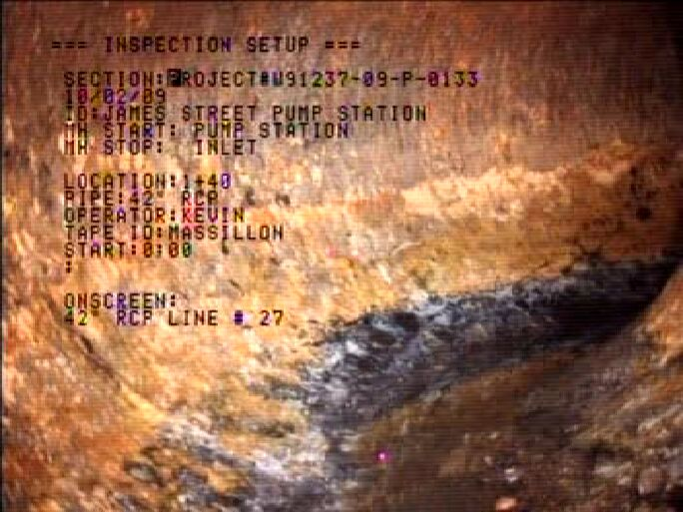
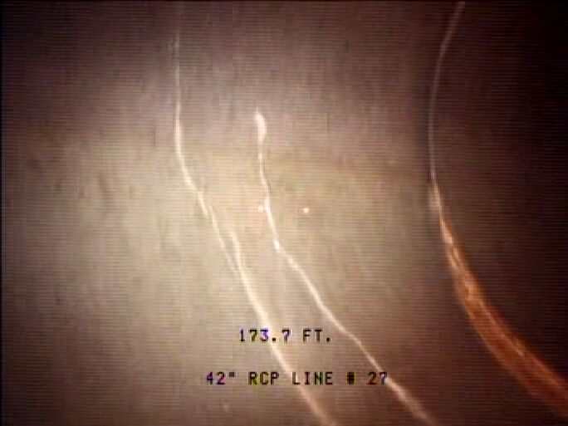

Slide 46
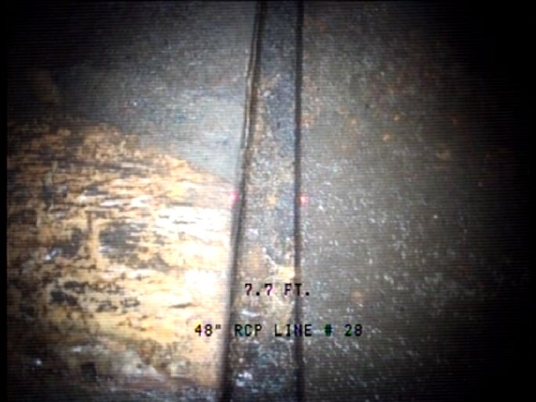
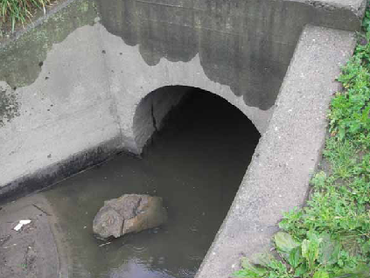
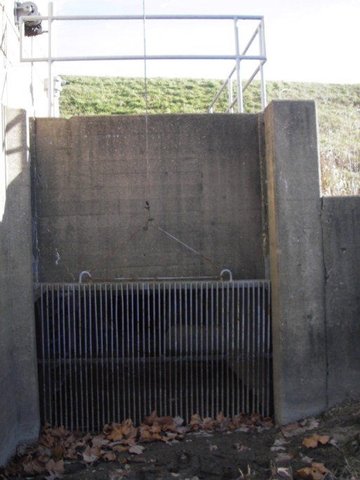
Pipe No. 28 James Avenue Pump Station 48-inch RCP Gravity Outlet

Slide 47
Pipes Inspected, Massillon Levee
Pipes | Size (Inches) | Material | Length (Feet) | Location
23 | 18 | RCP | 103 | West of RR with Flap Gate
24 | 12 | RCP? | 175 | Could not locate/unknown/does not exist
25 | 42 | RCP | 95 | Culvert through West Bank Levee opposite of Croose Avenue
26 | 66 | RCP | 93 | Culvert through East Bank Levee near control weir
27 | 42 | RCP | 360 | At inlet to siphon control weir
28 | 48 | RCP | 97 | James Avenue Pump Station Gravity Outlet
29 | 30 | CIP | 100 | Discharge from James Avenue Pump Station
30 | 30 | CIP | 100 | Discharge from James Avenue Pump Station
31 | 30 | CIP | 100 | Discharge from James Avenue Pump Station
32 | 60 | RCP | 135 | Federal Avenue Pump Station Outlet
33 | 60 | RCP | 135 | Federal Avenue Pump Station Outlet
34 | 30 | CIP | 141 | Discharge from Federal Avenue Pump Station
35 | 30 | CIP | 141 | Discharge from Federal Avenue Pump Station
36 | 30 | CIP | 141 | Discharge from Federal Avenue Pump Station
37 | 15'X10' | RCB | 120 | Sippo Creek Pump Station
38 | 24 | CIP | 5 | Discharge from Sippo Creek Pump Station
39 | 24 | CIP | 10 | Discharge from Sippo Creek Pump Station
40 | 24 | CIP | 20 | Discharge from Sippo Creek Pump Station
41 | 6'X6' | RCB | 87 | Gravity Arch Avenue Pump Station
42 | 6'X6' | RCB | 87 | Gravity Arch Avenue Pump Station
43 | 24 | CIP | 85 | Discharge from Arch Avenue Pump Station
44 | 24 | CIP | 85 | Discharge from Arch Avenue Pump Station
45 | 24 | CIP | 85 | Discharge from Arch Avenue Pump Station
46 | 48 | RCP | 90 | Gravity Conduit through levee
46b | 48 | CMP | 317 | Gravity Conduit MH upstream of Levee
47 | 24 | DIP | 460 | Siphon-Conduit-Brookfield Interceptor
48 | 14 | DIP | 460 | Siphon-Conduit-Brookfield Interceptor
49 | 20 | DIP | 460 | Siphon-Conduit-Brookfield Interceptor
50 | 18 | DIP | 460 | Siphon-Conduit-Wooster Trunk
51 | 10 | DIP | 460 | Siphon-Conduit-Wooster Trunk
52 | 15 | DIP | 460 | Siphon-Conduit-Wooster Trunk
53 | 8 | VCP | 450 | Siphon-Conduit-Tuscarawas River
54 | 10 | VCP | 450 | Siphon-Conduit-Tuscarawas River

Slide 48
James Avenue Pump Station
Pump station
Pump Stat. outlet
Pipe #26 outlet
Pipe # 26 inlet
Pipe #28
Pipe #27

Slide 49
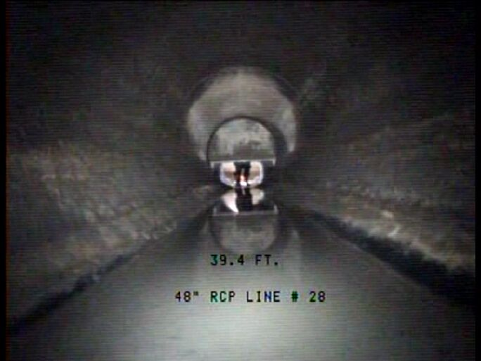
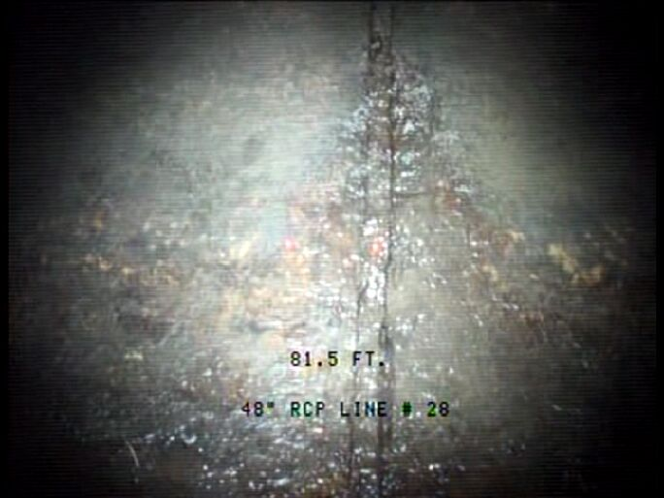
*Inspected inlet to out

Slide 52
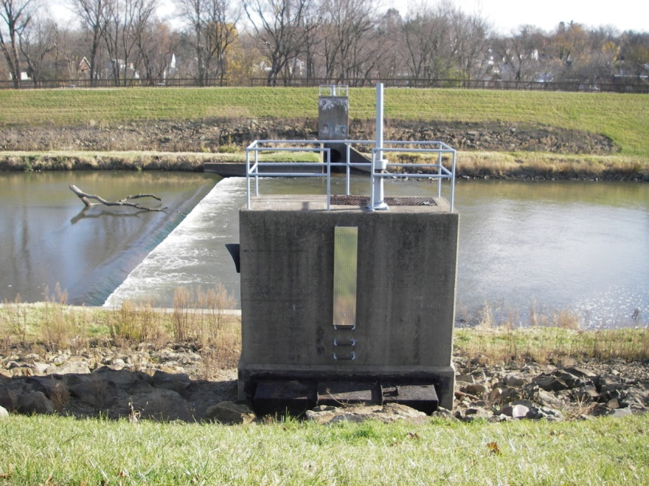
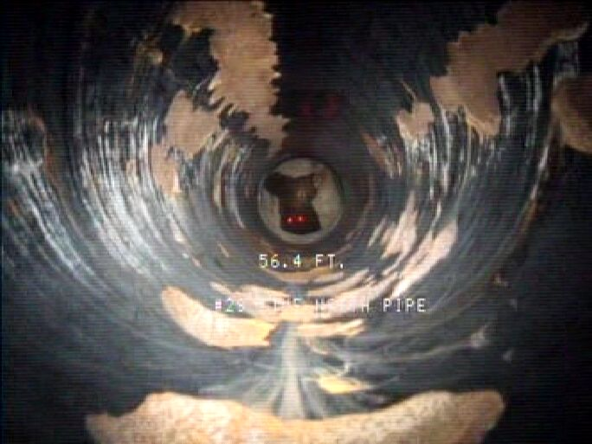
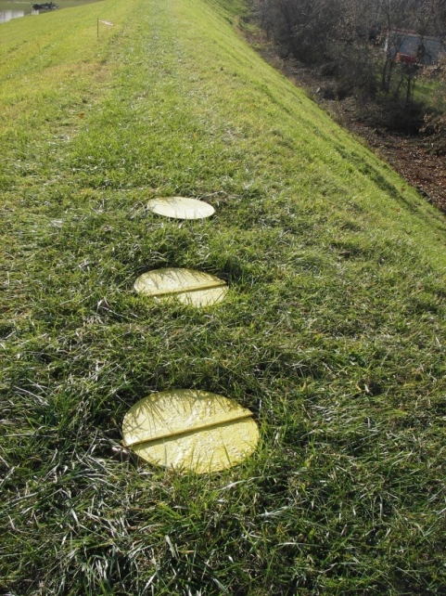
Pipe No. 29, 30, 31 30-Inch DIP Discharge Pipes

Slide 53
Pipes Inspected, Massillon Levee
Pipes | Size (Inches) | Material | Length (Feet) | Location
23 | 18 | RCP | 103 | West of RR with Flap Gate
24 | 12 | RCP? | 175 | Could not locate/unknown/does not exist
25 | 42 | RCP | 95 | Culvert through West Bank Levee opposite of Croose Avenue
26 | 66 | RCP | 93 | Culvert through East Bank Levee near control weir
27 | 42 | RCP | 360 | At inlet to siphon control weir
28 | 48 | RCP | 97 | James Avenue Pump Station Gravity Outlet
29 | 30 | CIP | 100 | Discharge from James Avenue Pump Station
30 | 30 | CIP | 100 | Discharge from James Avenue Pump Station
31 | 30 | CIP | 100 | Discharge from James Avenue Pump Station
32 | 60 | RCP | 135 | Federal Avenue Pump Station Outlet
33 | 60 | RCP | 135 | Federal Avenue Pump Station Outlet
34 | 30 | CIP | 141 | Discharge from Federal Avenue Pump Station
35 | 30 | CIP | 141 | Discharge from Federal Avenue Pump Station
36 | 30 | CIP | 141 | Discharge from Federal Avenue Pump Station
37 | 15'X10' | RCB | 120 | Sippo Creek Pump Station
38 | 24 | CIP | 5 | Discharge from Sippo Creek Pump Station
39 | 24 | CIP | 10 | Discharge from Sippo Creek Pump Station
40 | 24 | CIP | 20 | Discharge from Sippo Creek Pump Station
41 | 6'X6' | RCB | 87 | Gravity Arch Avenue Pump Station
42 | 6'X6' | RCB | 87 | Gravity Arch Avenue Pump Station
43 | 24 | CIP | 85 | Discharge from Arch Avenue Pump Station
44 | 24 | CIP | 85 | Discharge from Arch Avenue Pump Station
45 | 24 | CIP | 85 | Discharge from Arch Avenue Pump Station
46 | 48 | RCP | 90 | Gravity Conduit through levee
46b | 48 | CMP | 317 | Gravity Conduit MH upstream of Levee
47 | 24 | DIP | 460 | Siphon-Conduit-Brookfield Interceptor
48 | 14 | DIP | 460 | Siphon-Conduit-Brookfield Interceptor
49 | 20 | DIP | 460 | Siphon-Conduit-Brookfield Interceptor
50 | 18 | DIP | 460 | Siphon-Conduit-Wooster Trunk
51 | 10 | DIP | 460 | Siphon-Conduit-Wooster Trunk
52 | 15 | DIP | 460 | Siphon-Conduit-Wooster Trunk
53 | 8 | VCP | 450 | Siphon-Conduit-Tuscarawas River
54 | 10 | VCP | 450 | Siphon-Conduit-Tuscarawas River

Slide 54
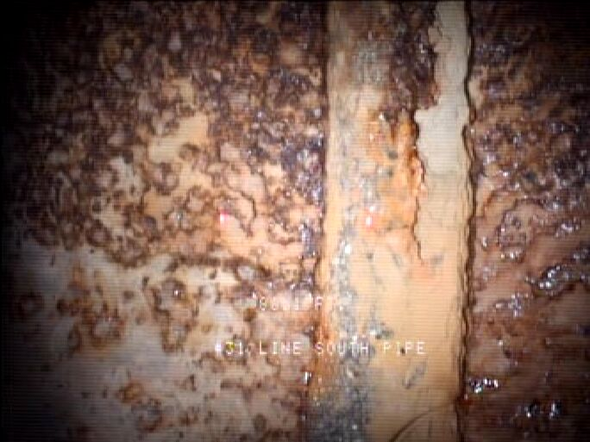
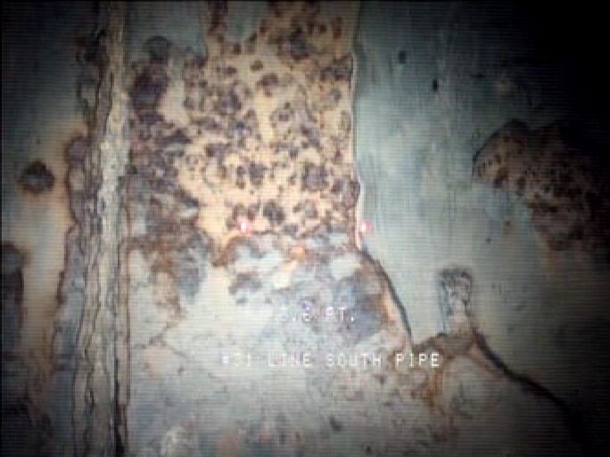

Slide 56
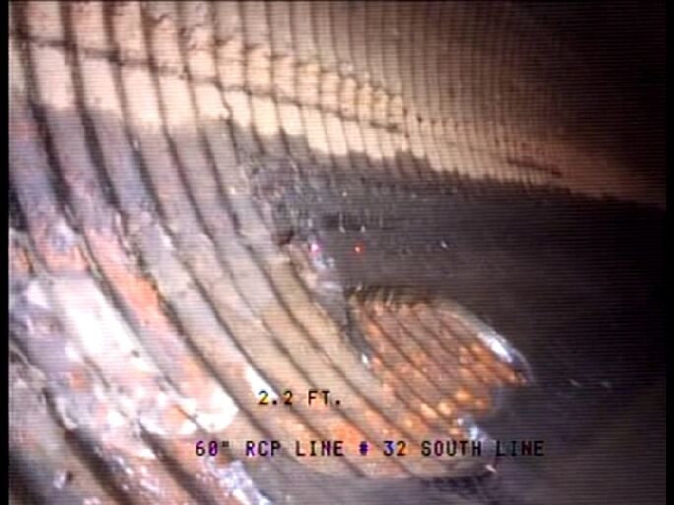
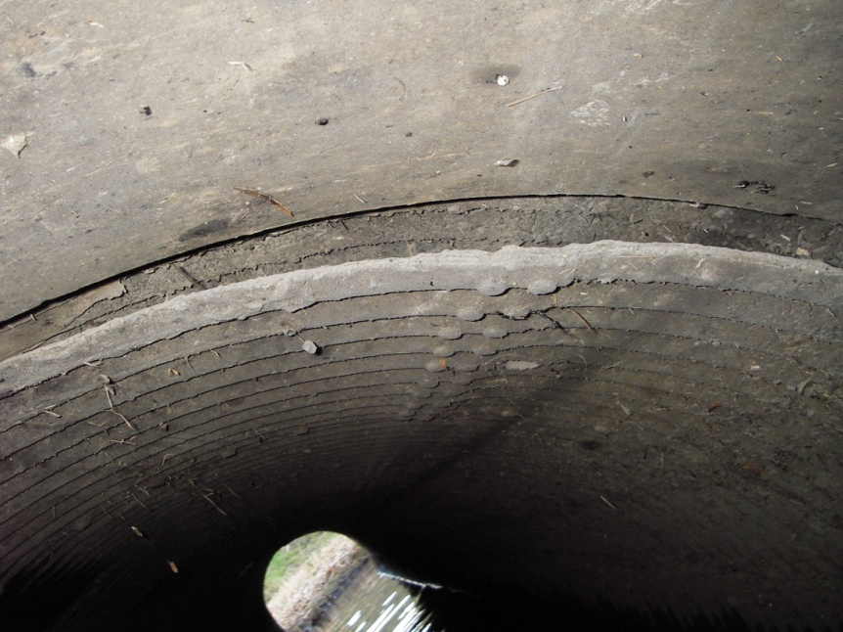

Massillon, Ohio Federal Avenue 60-Inch RCP Gravity Outlet Pipe #32 (South Pipe)

Slide 57
Pipes Inspected, Massillon Levee
Pipes | Size (Inches) | Material | Length (Feet) | Location
23 | 18 | RCP | 103 | West of RR with Flap Gate
24 | 12 | RCP? | 175 | Could not locate/unknown/does not exist
25 | 42 | RCP | 95 | Culvert through West Bank Levee opposite of Croose Avenue
26 | 66 | RCP | 93 | Culvert through East Bank Levee near control weir
27 | 42 | RCP | 360 | At inlet to siphon control weir
28 | 48 | RCP | 97 | James Avenue Pump Station Gravity Outlet
29 | 30 | CIP | 100 | Discharge from James Avenue Pump Station
30 | 30 | CIP | 100 | Discharge from James Avenue Pump Station
31 | 30 | CIP | 100 | Discharge from James Avenue Pump Station
32 | 60 | RCP | 135 | Federal Avenue Pump Station Outlet
33 | 60 | RCP | 135 | Federal Avenue Pump Station Outlet
34 | 30 | CIP | 141 | Discharge from Federal Avenue Pump Station
35 | 30 | CIP | 141 | Discharge from Federal Avenue Pump Station
36 | 30 | CIP | 141 | Discharge from Federal Avenue Pump Station
37 | 15'X10' | RCB | 120 | Sippo Creek Pump Station
38 | 24 | CIP | 5 | Discharge from Sippo Creek Pump Station
39 | 24 | CIP | 10 | Discharge from Sippo Creek Pump Station
40 | 24 | CIP | 20 | Discharge from Sippo Creek Pump Station
41 | 6'X6' | RCB | 87 | Gravity Arch Avenue Pump Station
42 | 6'X6' | RCB | 87 | Gravity Arch Avenue Pump Station
43 | 24 | CIP | 85 | Discharge from Arch Avenue Pump Station
44 | 24 | CIP | 85 | Discharge from Arch Avenue Pump Station
45 | 24 | CIP | 85 | Discharge from Arch Avenue Pump Station
46 | 48 | RCP | 90 | Gravity Conduit through levee
46b | 48 | CMP | 317 | Gravity Conduit MH upstream of Levee
47 | 24 | DIP | 460 | Siphon-Conduit-Brookfield Interceptor
48 | 14 | DIP | 460 | Siphon-Conduit-Brookfield Interceptor
49 | 20 | DIP | 460 | Siphon-Conduit-Brookfield Interceptor
50 | 18 | DIP | 460 | Siphon-Conduit-Wooster Trunk
51 | 10 | DIP | 460 | Siphon-Conduit-Wooster Trunk
52 | 15 | DIP | 460 | Siphon-Conduit-Wooster Trunk
53 | 8 | VCP | 450 | Siphon-Conduit-Tuscarawas River
54 | 10 | VCP | 450 | Siphon-Conduit-Tuscarawas River

Slide 58

Federal Avenue Pump Station
Pump station/Storm Drains
outlet

Slide 59



Slide 61


Slide 62


Massillon, Ohio Federal Avenue 60-Inch RCP Gravity Outlet Pipe #33 (North Pipe)

Slide 66



Massillon, Ohio Federal Avenue Pump Station Pipe #34, 35, and 36

Slide 67
Pipes Inspected, Massillon Levee
Pipes | Size (Inches) | Material | Length (Feet) | Location
23 | 18 | RCP | 103 | West of RR with Flap Gate
24 | 12 | RCP? | 175 | Could not locate/unknown/does not exist
25 | 42 | RCP | 95 | Culvert through West Bank Levee opposite of Croose Avenue
26 | 66 | RCP | 93 | Culvert through East Bank Levee near control weir
27 | 42 | RCP | 360 | At inlet to siphon control weir
28 | 48 | RCP | 97 | James Avenue Pump Station Gravity Outlet
29 | 30 | CIP | 100 | Discharge from James Avenue Pump Station
30 | 30 | CIP | 100 | Discharge from James Avenue Pump Station
31 | 30 | CIP | 100 | Discharge from James Avenue Pump Station
32 | 60 | RCP | 135 | Federal Avenue Pump Station Outlet
33 | 60 | RCP | 135 | Federal Avenue Pump Station Outlet
34 | 30 | CIP | 141 | Discharge from Federal Avenue Pump Station
35 | 30 | CIP | 141 | Discharge from Federal Avenue Pump Station
36 | 30 | CIP | 141 | Discharge from Federal Avenue Pump Station
37 | 15'X10' | RCB | 120 | Sippo Creek Pump Station
38 | 24 | CIP | 5 | Discharge from Sippo Creek Pump Station
39 | 24 | CIP | 10 | Discharge from Sippo Creek Pump Station
40 | 24 | CIP | 20 | Discharge from Sippo Creek Pump Station
41 | 6'X6' | RCB | 87 | Gravity Arch Avenue Pump Station
42 | 6'X6' | RCB | 87 | Gravity Arch Avenue Pump Station
43 | 24 | CIP | 85 | Discharge from Arch Avenue Pump Station
44 | 24 | CIP | 85 | Discharge from Arch Avenue Pump Station
45 | 24 | CIP | 85 | Discharge from Arch Avenue Pump Station
46 | 48 | RCP | 90 | Gravity Conduit through levee
46b | 48 | CMP | 317 | Gravity Conduit MH upstream of Levee
47 | 24 | DIP | 460 | Siphon-Conduit-Brookfield Interceptor
48 | 14 | DIP | 460 | Siphon-Conduit-Brookfield Interceptor
49 | 20 | DIP | 460 | Siphon-Conduit-Brookfield Interceptor
50 | 18 | DIP | 460 | Siphon-Conduit-Wooster Trunk
51 | 10 | DIP | 460 | Siphon-Conduit-Wooster Trunk
52 | 15 | DIP | 460 | Siphon-Conduit-Wooster Trunk
53 | 8 | VCP | 450 | Siphon-Conduit-Tuscarawas River
54 | 10 | VCP | 450 | Siphon-Conduit-Tuscarawas River

Slide 68




Slide 70



Massillon, Ohio Sippo Creek 15’x10’ RCB Pipe #37

Slide 71
Pipes Inspected, Massillon Levee
Pipes | Size (Inches) | Material | Length (Feet) | Location
23 | 18 | RCP | 103 | West of RR with Flap Gate
24 | 12 | RCP? | 175 | Could not locate/unknown/does not exist
25 | 42 | RCP | 95 | Culvert through West Bank Levee opposite of Croose Avenue
26 | 66 | RCP | 93 | Culvert through East Bank Levee near control weir
27 | 42 | RCP | 360 | At inlet to siphon control weir
28 | 48 | RCP | 97 | James Avenue Pump Station Gravity Outlet
29 | 30 | CIP | 100 | Discharge from James Avenue Pump Station
30 | 30 | CIP | 100 | Discharge from James Avenue Pump Station
31 | 30 | CIP | 100 | Discharge from James Avenue Pump Station
32 | 60 | RCP | 135 | Federal Avenue Pump Station Outlet
33 | 60 | RCP | 135 | Federal Avenue Pump Station Outlet
34 | 30 | CIP | 141 | Discharge from Federal Avenue Pump Station
35 | 30 | CIP | 141 | Discharge from Federal Avenue Pump Station
36 | 30 | CIP | 141 | Discharge from Federal Avenue Pump Station
37 | 15'X10' | RCB | 120 | Sippo Creek Pump Station
38 | 24 | CIP | 5 | Discharge from Sippo Creek Pump Station
39 | 24 | CIP | 10 | Discharge from Sippo Creek Pump Station
40 | 24 | CIP | 20 | Discharge from Sippo Creek Pump Station
41 | 6'X6' | RCB | 87 | Gravity Arch Avenue Pump Station
42 | 6'X6' | RCB | 87 | Gravity Arch Avenue Pump Station
43 | 24 | CIP | 85 | Discharge from Arch Avenue Pump Station
44 | 24 | CIP | 85 | Discharge from Arch Avenue Pump Station
45 | 24 | CIP | 85 | Discharge from Arch Avenue Pump Station
46 | 48 | RCP | 90 | Gravity Conduit through levee
46b | 48 | CMP | 317 | Gravity Conduit MH upstream of Levee
47 | 24 | DIP | 460 | Siphon-Conduit-Brookfield Interceptor
48 | 14 | DIP | 460 | Siphon-Conduit-Brookfield Interceptor
49 | 20 | DIP | 460 | Siphon-Conduit-Brookfield Interceptor
50 | 18 | DIP | 460 | Siphon-Conduit-Wooster Trunk
51 | 10 | DIP | 460 | Siphon-Conduit-Wooster Trunk
52 | 15 | DIP | 460 | Siphon-Conduit-Wooster Trunk
53 | 8 | VCP | 450 | Siphon-Conduit-Tuscarawas River
54 | 10 | VCP | 450 | Siphon-Conduit-Tuscarawas River

Slide 72

Sippo Avenue Pump Station
Outlet box
Pump station
Inlet

Slide 73




Slide 75


Massillon, Ohio Sippo Creek 24” DIP Pump Pipes Pipe #38, 39, 40

Slide 76
Pipes Inspected, Massillon Levee
Pipes | Size (Inches) | Material | Length (Feet) | Location
23 | 18 | RCP | 103 | West of RR with Flap Gate
24 | 12 | RCP? | 175 | Could not locate/unknown/does not exist
25 | 42 | RCP | 95 | Culvert through West Bank Levee opposite of Croose Avenue
26 | 66 | RCP | 93 | Culvert through East Bank Levee near control weir
27 | 42 | RCP | 360 | At inlet to siphon control weir
28 | 48 | RCP | 97 | James Avenue Pump Station Gravity Outlet
29 | 30 | CIP | 100 | Discharge from James Avenue Pump Station
30 | 30 | CIP | 100 | Discharge from James Avenue Pump Station
31 | 30 | CIP | 100 | Discharge from James Avenue Pump Station
32 | 60 | RCP | 135 | Federal Avenue Pump Station Outlet
33 | 60 | RCP | 135 | Federal Avenue Pump Station Outlet
34 | 30 | CIP | 141 | Discharge from Federal Avenue Pump Station
35 | 30 | CIP | 141 | Discharge from Federal Avenue Pump Station
36 | 30 | CIP | 141 | Discharge from Federal Avenue Pump Station
37 | 15'X10' | RCB | 120 | Sippo Creek Pump Station
38 | 24 | CIP | 5 | Discharge from Sippo Creek Pump Station
39 | 24 | CIP | 10 | Discharge from Sippo Creek Pump Station
40 | 24 | CIP | 20 | Discharge from Sippo Creek Pump Station
41 | 6'X6' | RCB | 87 | Gravity Arch Avenue Pump Station
42 | 6'X6' | RCB | 87 | Gravity Arch Avenue Pump Station
43 | 24 | CIP | 85 | Discharge from Arch Avenue Pump Station
44 | 24 | CIP | 85 | Discharge from Arch Avenue Pump Station
45 | 24 | CIP | 85 | Discharge from Arch Avenue Pump Station
46 | 48 | RCP | 90 | Gravity Conduit through levee
46b | 48 | CMP | 317 | Gravity Conduit MH upstream of Levee
47 | 24 | DIP | 460 | Siphon-Conduit-Brookfield Interceptor
48 | 14 | DIP | 460 | Siphon-Conduit-Brookfield Interceptor
49 | 20 | DIP | 460 | Siphon-Conduit-Brookfield Interceptor
50 | 18 | DIP | 460 | Siphon-Conduit-Wooster Trunk
51 | 10 | DIP | 460 | Siphon-Conduit-Wooster Trunk
52 | 15 | DIP | 460 | Siphon-Conduit-Wooster Trunk
53 | 8 | VCP | 450 | Siphon-Conduit-Tuscarawas River
54 | 10 | VCP | 450 | Siphon-Conduit-Tuscarawas River

Slide 77
Sippo Creek Pump Station
Pump Station Discharge Pipes
Outlet Structure
Pump Station
Pump Station Inlet

Slide 78



Slide 80



Massillon, Ohio Arch Avenue 6’x6’RCB Pipe #41 (North Box)

Slide 81
Pipes Inspected, Massillon Levee
Pipes | Size (Inches) | Material | Length (Feet) | Location
23 | 18 | RCP | 103 | West of RR with Flap Gate
24 | 12 | RCP? | 175 | Could not locate/unknown/does not exist
25 | 42 | RCP | 95 | Culvert through West Bank Levee opposite of Croose Avenue
26 | 66 | RCP | 93 | Culvert through East Bank Levee near control weir
27 | 42 | RCP | 360 | At inlet to siphon control weir
28 | 48 | RCP | 97 | James Avenue Pump Station Gravity Outlet
29 | 30 | CIP | 100 | Discharge from James Avenue Pump Station
30 | 30 | CIP | 100 | Discharge from James Avenue Pump Station
31 | 30 | CIP | 100 | Discharge from James Avenue Pump Station
32 | 60 | RCP | 135 | Federal Avenue Pump Station Outlet
33 | 60 | RCP | 135 | Federal Avenue Pump Station Outlet
34 | 30 | CIP | 141 | Discharge from Federal Avenue Pump Station
35 | 30 | CIP | 141 | Discharge from Federal Avenue Pump Station
36 | 30 | CIP | 141 | Discharge from Federal Avenue Pump Station
37 | 15'X10' | RCB | 120 | Sippo Creek Pump Station
38 | 24 | CIP | 5 | Discharge from Sippo Creek Pump Station
39 | 24 | CIP | 10 | Discharge from Sippo Creek Pump Station
40 | 24 | CIP | 20 | Discharge from Sippo Creek Pump Station
41 | 6'X6' | RCB | 87 | Gravity Arch Avenue Pump Station
42 | 6'X6' | RCB | 87 | Gravity Arch Avenue Pump Station
43 | 24 | CIP | 85 | Discharge from Arch Avenue Pump Station
44 | 24 | CIP | 85 | Discharge from Arch Avenue Pump Station
45 | 24 | CIP | 85 | Discharge from Arch Avenue Pump Station
46 | 48 | RCP | 90 | Gravity Conduit through levee
46b | 48 | CMP | 317 | Gravity Conduit MH upstream of Levee
47 | 24 | DIP | 460 | Siphon-Conduit-Brookfield Interceptor
48 | 14 | DIP | 460 | Siphon-Conduit-Brookfield Interceptor
49 | 20 | DIP | 460 | Siphon-Conduit-Brookfield Interceptor
50 | 18 | DIP | 460 | Siphon-Conduit-Wooster Trunk
51 | 10 | DIP | 460 | Siphon-Conduit-Wooster Trunk
52 | 15 | DIP | 460 | Siphon-Conduit-Wooster Trunk
53 | 8 | VCP | 450 | Siphon-Conduit-Tuscarawas River
54 | 10 | VCP | 450 | Siphon-Conduit-Tuscarawas River

Slide 82

Arch Avenue Pump Station
Pump Station
Discharge Well and Outlet
Gravity Conduit Outlet

Slide 83


*First part of the structure from the inlet to gatewell is RCB,
gatewell to outlet is RCP

Slide 85



Massillon, Ohio Arch Avenue 6’x6’RCB Pipe #42 (South Box)

Slide 86


*First part of the structure from the inlet to gatewell is RCB,
gatewell to outlet is RCP

Slide 88



Massillon, Ohio Arch Avenue 24” CIP Pump Pipes Pipe #43 (South), 44 (Center), 45 (North)

Slide 89
Pipes Inspected, Massillon Levee
Pipes | Size (Inches) | Material | Length (Feet) | Location
23 | 18 | RCP | 103 | West of RR with Flap Gate
24 | 12 | RCP? | 175 | Could not locate/unknown/does not exist
25 | 42 | RCP | 95 | Culvert through West Bank Levee opposite of Croose Avenue
26 | 66 | RCP | 93 | Culvert through East Bank Levee near control weir
27 | 42 | RCP | 360 | At inlet to siphon control weir
28 | 48 | RCP | 97 | James Avenue Pump Station Gravity Outlet
29 | 30 | CIP | 100 | Discharge from James Avenue Pump Station
30 | 30 | CIP | 100 | Discharge from James Avenue Pump Station
31 | 30 | CIP | 100 | Discharge from James Avenue Pump Station
32 | 60 | RCP | 135 | Federal Avenue Pump Station Outlet
33 | 60 | RCP | 135 | Federal Avenue Pump Station Outlet
34 | 30 | CIP | 141 | Discharge from Federal Avenue Pump Station
35 | 30 | CIP | 141 | Discharge from Federal Avenue Pump Station
36 | 30 | CIP | 141 | Discharge from Federal Avenue Pump Station
37 | 15'X10' | RCP | 120 | Sippo Avenue Pump Station
38 | 24 | CIP | 5 | Discharge from Sippo Avenue Pump Station
39 | 24 | CIP | 10 | Discharge from Sippo Avenue Pump Station
40 | 24 | CIP | 20 | Discharge from Sippo Avenue Pump Station
41 | 6'X6' | RCP | 87 | Gravity Arch Avenue Pump Station
42 | 6'X6' | RCP | 87 | Gravity Arch Avenue Pump Station
43 | 24 | CIP | 85 | Discharge from Arch Avenue Pump Station
44 | 24 | CIP | 85 | Discharge from Arch Avenue Pump Station
45 | 24 | CIP | 85 | Discharge from Arch Avenue Pump Station
46 | 48 | RCP | 90 | Gravity Conduit through levee
46b | 48 | CMP | 317 | Gravity Conduit MH upstream of Levee
47 | 24 | DIP | 460 | Siphon-Conduit-Brookfield Interceptor
48 | 14 | DIP | 460 | Siphon-Conduit-Brookfield Interceptor
49 | 20 | DIP | 460 | Siphon-Conduit-Brookfield Interceptor
50 | 18 | DIP | 460 | Siphon-Conduit-Wooster Trunk
51 | 10 | DIP | 460 | Siphon-Conduit-Wooster Trunk
52 | 15 | DIP | 460 | Siphon-Conduit-Wooster Trunk
53 | 8 | VCP | 450 | Siphon-Conduit-Tuscarawas River
54 | 10 | VCP | 450 | Siphon-Conduit-Tuscarawas River

Slide 90

Arch Avenue Pump Station
Pump Station
Pump/box Outlet

Slide 91




Slide 93



Massillon, Ohio Arch Avenue Gravity-RCP Pipe #46 (MH downgrade through levee)

Slide 94

Approx. Location of Inlet
Pipe No. 46B, CMP Gravity
Pipe No. 46, RCP
MH

Slide 95
Pipes Inspected, Massillon Levee
Pipes | Size (Inches) | Material | Length (Feet) | Location
23 | 18 | RCP | 103 | West of RR with Flap Gate
24 | 12 | RCP? | 175 | Could not locate/unknown/does not exist
25 | 42 | RCP | 95 | Culvert through West Bank Levee opposite of Croose Avenue
26 | 66 | RCP | 93 | Culvert through East Bank Levee near control weir
27 | 42 | RCP | 360 | At inlet to siphon control weir
28 | 48 | RCP | 97 | James Avenue Pump Station Gravity Outlet
29 | 30 | CIP | 100 | Discharge from James Avenue Pump Station
30 | 30 | CIP | 100 | Discharge from James Avenue Pump Station
31 | 30 | CIP | 100 | Discharge from James Avenue Pump Station
32 | 60 | RCP | 135 | Federal Avenue Pump Station Outlet
33 | 60 | RCP | 135 | Federal Avenue Pump Station Outlet
34 | 30 | CIP | 141 | Discharge from Federal Avenue Pump Station
35 | 30 | CIP | 141 | Discharge from Federal Avenue Pump Station
36 | 30 | CIP | 141 | Discharge from Federal Avenue Pump Station
37 | 15'X10' | RCB | 120 | Sippo Creek Pump Station
38 | 24 | CIP | 5 | Discharge from Sippo Creek Pump Station
39 | 24 | CIP | 10 | Discharge from Sippo Creek Pump Station
40 | 24 | CIP | 20 | Discharge from Sippo Creek Pump Station
41 | 6'X6' | RCB | 87 | Gravity Arch Avenue Pump Station
42 | 6'X6' | RCB | 87 | Gravity Arch Avenue Pump Station
43 | 24 | CIP | 85 | Discharge from Arch Avenue Pump Station
44 | 24 | CIP | 85 | Discharge from Arch Avenue Pump Station
45 | 24 | CIP | 85 | Discharge from Arch Avenue Pump Station
46 | 48 | RCP | 90 | Gravity Conduit through levee
46b | 48 | CMP | 317 | Gravity Conduit MH upstream of Levee
47 | 24 | DIP | 460 | Siphon-Conduit-Brookfield Interceptor
48 | 14 | DIP | 460 | Siphon-Conduit-Brookfield Interceptor
49 | 20 | DIP | 460 | Siphon-Conduit-Brookfield Interceptor
50 | 18 | DIP | 460 | Siphon-Conduit-Wooster Trunk
51 | 10 | DIP | 460 | Siphon-Conduit-Wooster Trunk
52 | 15 | DIP | 460 | Siphon-Conduit-Wooster Trunk
53 | 8 | VCP | 450 | Siphon-Conduit-Tuscarawas River
54 | 10 | VCP | 450 | Siphon-Conduit-Tuscarawas River

Slide 96



Slide 98
Massillon, Ohio Arch Avenue Gravity-CMP Pipe #46b (From MH going upstream under road)

Slide 99




Slide 101
Massillon, Ohio Brookfield and Wooster Sanitary Sewer Siphons

Slide 102
Brookfield siphon inlet
Wooster siphon inlet
Brookfield siphon outlet
Wooster siphon outlet

Slide 103
Pipes Inspected, Massillon Levee
Pipes | Size (Inches) | Material | Length (Feet) | Location
23 | 18 | RCP | 103 | West of RR with Flap Gate
24 | 12 | RCP? | 175 | Could not locate/unknown/does not exist
25 | 42 | RCP | 95 | Culvert through West Bank Levee opposite of Croose Avenue
26 | 66 | RCP | 93 | Culvert through East Bank Levee near control weir
27 | 42 | RCP | 360 | At inlet to siphon control weir
28 | 48 | RCP | 97 | James Avenue Pump Station Gravity Outlet
29 | 30 | CIP | 100 | Discharge from James Avenue Pump Station
30 | 30 | CIP | 100 | Discharge from James Avenue Pump Station
31 | 30 | CIP | 100 | Discharge from James Avenue Pump Station
32 | 60 | RCP | 135 | Federal Avenue Pump Station Outlet
33 | 60 | RCP | 135 | Federal Avenue Pump Station Outlet
34 | 30 | CIP | 141 | Discharge from Federal Avenue Pump Station
35 | 30 | CIP | 141 | Discharge from Federal Avenue Pump Station
36 | 30 | CIP | 141 | Discharge from Federal Avenue Pump Station
37 | 15'X10' | RCB | 120 | Sippo Creek Pump Station
38 | 24 | CIP | 5 | Discharge from Sippo Creek Pump Station
39 | 24 | CIP | 10 | Discharge from Sippo Creek Pump Station
40 | 24 | CIP | 20 | Discharge from Sippo Creek Pump Station
41 | 6'X6' | RCB | 87 | Gravity Arch Avenue Pump Station
42 | 6'X6' | RCB | 87 | Gravity Arch Avenue Pump Station
43 | 24 | CIP | 85 | Discharge from Arch Avenue Pump Station
44 | 24 | CIP | 85 | Discharge from Arch Avenue Pump Station
45 | 24 | CIP | 85 | Discharge from Arch Avenue Pump Station
46 | 48 | RCP | 90 | Gravity Conduit through levee
46b | 48 | CMP | 317 | Gravity Conduit MH upstream of Levee
47 | 24 | DIP | 460 | Sanitary Siphon-Conduit-Brookfield Interceptor
48 | 14 | DIP | 460 | Sanitary Siphon-Conduit-Brookfield Interceptor
49 | 20 | DIP | 460 | Sanitary Siphon-Conduit-Brookfield Interceptor
50 | 18 | DIP | 460 | Sanitary Siphon-Conduit-Wooster Trunk
51 | 10 | DIP | 460 | Sanitary Siphon-Conduit-Wooster Trunk
52 | 15 | DIP | 460 | Sanitary Siphon-Conduit-Wooster Trunk
53 | 8 | VCP | 450 | Sanitary Siphon-Conduit-Tuscarawas River
54 | 10 | VCP | 450 | Sanitary Siphon-Conduit-Tuscarawas River

Slide 104
Massillon, Ohio Brookfield Siphons Pipe #47, 48, 49

Slide 105
Pipes Inspected, Massillon Levee
Pipes | Size (Inches) | Material | Length (Feet) | Location
23 | 18 | RCP | 103 | West of RR with Flap Gate
24 | 12 | RCP? | 175 | Could not locate/unknown/does not exist
25 | 42 | RCP | 95 | Culvert through West Bank Levee opposite of Croose Avenue
26 | 66 | RCP | 93 | Culvert through East Bank Levee near control weir
27 | 42 | RCP | 360 | At inlet to siphon control weir
28 | 48 | RCP | 97 | James Avenue Pump Station Gravity Outlet
29 | 30 | CIP | 100 | Discharge from James Avenue Pump Station
30 | 30 | CIP | 100 | Discharge from James Avenue Pump Station
31 | 30 | CIP | 100 | Discharge from James Avenue Pump Station
32 | 60 | RCP | 135 | Federal Avenue Pump Station Outlet
33 | 60 | RCP | 135 | Federal Avenue Pump Station Outlet
34 | 30 | CIP | 141 | Discharge from Federal Avenue Pump Station
35 | 30 | CIP | 141 | Discharge from Federal Avenue Pump Station
36 | 30 | CIP | 141 | Discharge from Federal Avenue Pump Station
37 | 15'X10' | RCP | 120 | Sippo Avenue Pump Station
38 | 24 | CIP | 5 | Discharge from Sippo Avenue Pump Station
39 | 24 | CIP | 10 | Discharge from Sippo Avenue Pump Station
40 | 24 | CIP | 20 | Discharge from Sippo Avenue Pump Station
41 | 6'X6' | RCP | 87 | Gravity Arch Avenue Pump Station
42 | 6'X6' | RCP | 87 | Gravity Arch Avenue Pump Station
43 | 24 | CIP | 85 | Discharge from Arch Avenue Pump Station
44 | 24 | CIP | 85 | Discharge from Arch Avenue Pump Station
45 | 24 | CIP | 85 | Discharge from Arch Avenue Pump Station
46 | 48 | RCP | 90 | Gravity Conduit through levee
46b | 48 | CMP | 317 | Gravity Conduit MH upstream of Levee
47 | 24 | DIP | 460 | Siphon-Conduit-Brookfield Interceptor
48 | 14 | DIP | 460 | Siphon-Conduit-Brookfield Interceptor
49 | 20 | DIP | 460 | Siphon-Conduit-Brookfield Interceptor
50 | 18 | DIP | 460 | Siphon-Conduit-Wooster Trunk
51 | 10 | DIP | 460 | Siphon-Conduit-Wooster Trunk
52 | 15 | DIP | 460 | Siphon-Conduit-Wooster Trunk
53 | 8 | VCP | 450 | Siphon-Conduit-Tuscarawas River
54 | 10 | VCP | 450 | Siphon-Conduit-Tuscarawas River

Slide 106

Brookfield Siphon outlet box

Slide 107
Massillon, Ohio Brookfield Sanitary Sewer Siphon Pipe #47, 24-inch DIP

Slide 108
Pipes Inspected, Massillon Levee
Pipes | Size (Inches) | Material | Length (Feet) | Location
23 | 18 | RCP | 103 | West of RR with Flap Gate
24 | 12 | RCP? | 175 | Could not locate/unknown/does not exist
25 | 42 | RCP | 95 | Culvert through West Bank Levee opposite of Croose Avenue
26 | 66 | RCP | 93 | Culvert through East Bank Levee near control weir
27 | 42 | RCP | 360 | At inlet to siphon control weir
28 | 48 | RCP | 97 | James Avenue Pump Station Gravity Outlet
29 | 30 | CIP | 100 | Discharge from James Avenue Pump Station
30 | 30 | CIP | 100 | Discharge from James Avenue Pump Station
31 | 30 | CIP | 100 | Discharge from James Avenue Pump Station
32 | 60 | RCP | 135 | Federal Avenue Pump Station Outlet
33 | 60 | RCP | 135 | Federal Avenue Pump Station Outlet
34 | 30 | CIP | 141 | Discharge from Federal Avenue Pump Station
35 | 30 | CIP | 141 | Discharge from Federal Avenue Pump Station
36 | 30 | CIP | 141 | Discharge from Federal Avenue Pump Station
37 | 15'X10' | RCP | 120 | Sippo Avenue Pump Station
38 | 24 | CIP | 5 | Discharge from Sippo Avenue Pump Station
39 | 24 | CIP | 10 | Discharge from Sippo Avenue Pump Station
40 | 24 | CIP | 20 | Discharge from Sippo Avenue Pump Station
41 | 6'X6' | RCP | 87 | Gravity Arch Avenue Pump Station
42 | 6'X6' | RCP | 87 | Gravity Arch Avenue Pump Station
43 | 24 | CIP | 85 | Discharge from Arch Avenue Pump Station
44 | 24 | CIP | 85 | Discharge from Arch Avenue Pump Station
45 | 24 | CIP | 85 | Discharge from Arch Avenue Pump Station
46 | 48 | RCP | 90 | Gravity Conduit through levee
46b | 48 | CMP | 317 | Gravity Conduit MH upstream of Levee
47 | 24 | DIP | 460 | Sanitary Siphon-Conduit-Brookfield Interceptor
48 | 14 | DIP | 460 | Sanitary Siphon-Conduit-Brookfield Interceptor
49 | 20 | DIP | 460 | Sanitary Siphon-Conduit-Brookfield Interceptor
50 | 18 | DIP | 460 | Sanitary Siphon-Conduit-Wooster Trunk
51 | 10 | DIP | 460 | Sanitary Siphon-Conduit-Wooster Trunk
52 | 15 | DIP | 460 | Sanitary Siphon-Conduit-Wooster Trunk
53 | 8 | VCP | 450 | Sanitary Siphon-Conduit-Tuscarawas River
54 | 10 | VCP | 450 | Sanitary Siphon-Conduit-Tuscarawas River

Slide 109




Slide 111
Massillon, Ohio Brookfield Sanitary Sewer Siphon Pipe #48, 14-inch DIP

Slide 112
Pipes Inspected, Massillon Levee
Pipes | Size (Inches) | Material | Length (Feet) | Location
23 | 18 | RCP | 103 | West of RR with Flap Gate
24 | 12 | RCP? | 175 | Could not locate/unknown/does not exist
25 | 42 | RCP | 95 | Culvert through West Bank Levee opposite of Croose Avenue
26 | 66 | RCP | 93 | Culvert through East Bank Levee near control weir
27 | 42 | RCP | 360 | At inlet to siphon control weir
28 | 48 | RCP | 97 | James Avenue Pump Station Gravity Outlet
29 | 30 | CIP | 100 | Discharge from James Avenue Pump Station
30 | 30 | CIP | 100 | Discharge from James Avenue Pump Station
31 | 30 | CIP | 100 | Discharge from James Avenue Pump Station
32 | 60 | RCP | 135 | Federal Avenue Pump Station Outlet
33 | 60 | RCP | 135 | Federal Avenue Pump Station Outlet
34 | 30 | CIP | 141 | Discharge from Federal Avenue Pump Station
35 | 30 | CIP | 141 | Discharge from Federal Avenue Pump Station
36 | 30 | CIP | 141 | Discharge from Federal Avenue Pump Station
37 | 15'X10' | RCB | 120 | Sippo Creek Pump Station
38 | 24 | CIP | 5 | Discharge from Sippo Creek Pump Station
39 | 24 | CIP | 10 | Discharge from Sippo Creek Pump Station
40 | 24 | CIP | 20 | Discharge from Sippo Creek Pump Station
41 | 6'X6' | RCB | 87 | Gravity Arch Avenue Pump Station
42 | 6'X6' | RCB | 87 | Gravity Arch Avenue Pump Station
43 | 24 | CIP | 85 | Discharge from Arch Avenue Pump Station
44 | 24 | CIP | 85 | Discharge from Arch Avenue Pump Station
45 | 24 | CIP | 85 | Discharge from Arch Avenue Pump Station
46 | 48 | RCP | 90 | Gravity Conduit through levee
46b | 48 | CMP | 317 | Gravity Conduit MH upstream of Levee
47 | 24 | DIP | 460 | Sanitary Siphon-Conduit-Brookfield Interceptor
48 | 14 | DIP | 460 | Sanitary Siphon-Conduit-Brookfield Interceptor
49 | 20 | DIP | 460 | Sanitary Siphon-Conduit-Brookfield Interceptor
50 | 18 | DIP | 460 | Sanitary Siphon-Conduit-Wooster Trunk
51 | 10 | DIP | 460 | Sanitary Siphon-Conduit-Wooster Trunk
52 | 15 | DIP | 460 | Sanitary Siphon-Conduit-Wooster Trunk
53 | 8 | VCP | 450 | Sanitary Siphon-Conduit-Tuscarawas River
54 | 10 | VCP | 450 | Sanitary Siphon-Conduit-Tuscarawas River

Slide 113




Slide 115
Massillon, Ohio Brookfield Sanitary Sewer Siphon Pipe #49, 20-inch DIP

Slide 116
Pipes Inspected, Massillon Levee
Pipes | Size (Inches) | Material | Length (Feet) | Location
23 | 18 | RCP | 103 | West of RR with Flap Gate
24 | 12 | RCP? | 175 | Could not locate/unknown/does not exist
25 | 42 | RCP | 95 | Culvert through West Bank Levee opposite of Croose Avenue
26 | 66 | RCP | 93 | Culvert through East Bank Levee near control weir
27 | 42 | RCP | 360 | At inlet to siphon control weir
28 | 48 | RCP | 97 | James Avenue Pump Station Gravity Outlet
29 | 30 | CIP | 100 | Discharge from James Avenue Pump Station
30 | 30 | CIP | 100 | Discharge from James Avenue Pump Station
31 | 30 | CIP | 100 | Discharge from James Avenue Pump Station
32 | 60 | RCP | 135 | Federal Avenue Pump Station Outlet
33 | 60 | RCP | 135 | Federal Avenue Pump Station Outlet
34 | 30 | CIP | 141 | Discharge from Federal Avenue Pump Station
35 | 30 | CIP | 141 | Discharge from Federal Avenue Pump Station
36 | 30 | CIP | 141 | Discharge from Federal Avenue Pump Station
37 | 15'X10' | RCB | 120 | Sippo Creek Pump Station
38 | 24 | CIP | 5 | Discharge from Sippo Creek Pump Station
39 | 24 | CIP | 10 | Discharge from Sippo Creek Pump Station
40 | 24 | CIP | 20 | Discharge from Sippo Creek Pump Station
41 | 6'X6' | RCB | 87 | Gravity Arch Avenue Pump Station
42 | 6'X6' | RCB | 87 | Gravity Arch Avenue Pump Station
43 | 24 | CIP | 85 | Discharge from Arch Avenue Pump Station
44 | 24 | CIP | 85 | Discharge from Arch Avenue Pump Station
45 | 24 | CIP | 85 | Discharge from Arch Avenue Pump Station
46 | 48 | RCP | 90 | Gravity Conduit through levee
46b | 48 | CMP | 317 | Gravity Conduit MH upstream of Levee
47 | 24 | DIP | 460 | Sanitary Siphon-Conduit-Brookfield Interceptor
48 | 14 | DIP | 460 | Sanitary Siphon-Conduit-Brookfield Interceptor
49 | 20 | DIP | 460 | Sanitary Siphon-Conduit-Brookfield Interceptor
50 | 18 | DIP | 460 | Sanitary Siphon-Conduit-Wooster Trunk
51 | 10 | DIP | 460 | Sanitary Siphon-Conduit-Wooster Trunk
52 | 15 | DIP | 460 | Sanitary Siphon-Conduit-Wooster Trunk
53 | 8 | VCP | 450 | Sanitary Siphon-Conduit-Tuscarawas River
54 | 10 | VCP | 450 | Sanitary Siphon-Conduit-Tuscarawas River

Slide 117



*Inspected from outlet to inlet

Slide 119
Massillon, Ohio Wooster Siphons Pipe #50, 51, 52 Gate valve in pipe 51 and 52 were frozen mid way, pipes could not be inspected.

Slide 120
Pipes Inspected, Massillon Levee
Pipes | Size (Inches) | Material | Length (Feet) | Location
23 | 18 | RCP | 103 | West of RR with Flap Gate
24 | 12 | RCP? | 175 | Could not locate/unknown/does not exist
25 | 42 | RCP | 95 | Culvert through West Bank Levee opposite of Croose Avenue
26 | 66 | RCP | 93 | Culvert through East Bank Levee near control weir
27 | 42 | RCP | 360 | At inlet to siphon control weir
28 | 48 | RCP | 97 | James Avenue Pump Station Gravity Outlet
29 | 30 | CIP | 100 | Discharge from James Avenue Pump Station
30 | 30 | CIP | 100 | Discharge from James Avenue Pump Station
31 | 30 | CIP | 100 | Discharge from James Avenue Pump Station
32 | 60 | RCP | 135 | Federal Avenue Pump Station Outlet
33 | 60 | RCP | 135 | Federal Avenue Pump Station Outlet
34 | 30 | CIP | 141 | Discharge from Federal Avenue Pump Station
35 | 30 | CIP | 141 | Discharge from Federal Avenue Pump Station
36 | 30 | CIP | 141 | Discharge from Federal Avenue Pump Station
37 | 15'X10' | RCB | 120 | Sippo Creek Pump Station
38 | 24 | CIP | 5 | Discharge from Sippo Creek Pump Station
39 | 24 | CIP | 10 | Discharge from Sippo Creek Pump Station
40 | 24 | CIP | 20 | Discharge from Sippo Creek Pump Station
41 | 6'X6' | RCB | 87 | Gravity Arch Avenue Pump Station
42 | 6'X6' | RCB | 87 | Gravity Arch Avenue Pump Station
43 | 24 | CIP | 85 | Discharge from Arch Avenue Pump Station
44 | 24 | CIP | 85 | Discharge from Arch Avenue Pump Station
45 | 24 | CIP | 85 | Discharge from Arch Avenue Pump Station
46 | 48 | RCP | 90 | Gravity Conduit through levee
46b | 48 | CMP | 317 | Gravity Conduit MH upstream of Levee
47 | 24 | DIP | 460 | Sanitary Siphon-Conduit-Brookfield Interceptor
48 | 14 | DIP | 460 | Sanitary Siphon-Conduit-Brookfield Interceptor
49 | 20 | DIP | 460 | Sanitary Siphon-Conduit-Brookfield Interceptor
50 | 18 | DIP | 460 | Sanitary Siphon-Conduit-Wooster Trunk
51 | 10 | DIP | 460 | Sanitary Siphon-Conduit-Wooster Trunk (Could not be inspected)
52 | 15 | DIP | 460 | Sanitary Siphon-Conduit-Wooster Trunk (Could not be inspected)
53 | 8 | VCP | 450 | Sanitary Siphon-Conduit-Tuscarawas River
54 | 10 | VCP | 450 | Sanitary Siphon-Conduit-Tuscarawas River

Slide 121
Brookfield siphon inlet
Wooster siphon inlet
Brookfield siphon outlet
Wooster siphon outlet

Slide 122
Massillon, Ohio Wooster Sanitary Sewer Siphons Pipe #50, 18” DIP

Slide 123
Pipes Inspected, Massillon Levee
Pipes | Size (Inches) | Material | Length (Feet) | Location
23 | 18 | RCP | 103 | West of RR with Flap Gate
24 | 12 | RCP? | 175 | Could not locate/unknown/does not exist
25 | 42 | RCP | 95 | Culvert through West Bank Levee opposite of Croose Avenue
26 | 66 | RCP | 93 | Culvert through East Bank Levee near control weir
27 | 42 | RCP | 360 | At inlet to siphon control weir
28 | 48 | RCP | 97 | James Avenue Pump Station Gravity Outlet
29 | 30 | CIP | 100 | Discharge from James Avenue Pump Station
30 | 30 | CIP | 100 | Discharge from James Avenue Pump Station
31 | 30 | CIP | 100 | Discharge from James Avenue Pump Station
32 | 60 | RCP | 135 | Federal Avenue Pump Station Outlet
33 | 60 | RCP | 135 | Federal Avenue Pump Station Outlet
34 | 30 | CIP | 141 | Discharge from Federal Avenue Pump Station
35 | 30 | CIP | 141 | Discharge from Federal Avenue Pump Station
36 | 30 | CIP | 141 | Discharge from Federal Avenue Pump Station
37 | 15'X10' | RCB | 120 | Sippo Creek Pump Station
38 | 24 | CIP | 5 | Discharge from Sippo Creek Pump Station
39 | 24 | CIP | 10 | Discharge from Sippo Creek Pump Station
40 | 24 | CIP | 20 | Discharge from Sippo Creek Pump Station
41 | 6'X6' | RCB | 87 | Gravity Arch Avenue Pump Station
42 | 6'X6' | RCB | 87 | Gravity Arch Avenue Pump Station
43 | 24 | CIP | 85 | Discharge from Arch Avenue Pump Station
44 | 24 | CIP | 85 | Discharge from Arch Avenue Pump Station
45 | 24 | CIP | 85 | Discharge from Arch Avenue Pump Station
46 | 48 | RCP | 90 | Gravity Conduit through levee
46b | 48 | CMP | 317 | Gravity Conduit MH upstream of Levee
47 | 24 | DIP | 460 | Sanitary Siphon-Conduit-Brookfield Interceptor
48 | 14 | DIP | 460 | Sanitary Siphon-Conduit-Brookfield Interceptor
49 | 20 | DIP | 460 | Sanitary Siphon-Conduit-Brookfield Interceptor
50 | 18 | DIP | 460 | Sanitary Siphon-Conduit-Wooster Trunk
51 | 10 | DIP | 460 | Sanitary Siphon-Conduit-Wooster Trunk (Could not be inspected)
52 | 15 | DIP | 460 | Sanitary Siphon-Conduit-Wooster Trunk (Could not be inspected)
53 | 8 | VCP | 450 | Sanitary Siphon-Conduit-Tuscarawas River
54 | 10 | VCP | 450 | Sanitary Siphon-Conduit-Tuscarawas River

Slide 124




Slide 126
Massillon, Ohio Wooster Siphons Pipe #51 and 52 10” and 15” DIP Pipes could not be inspected due to the gate valves being froze mid way.

Slide 127
Pipes Inspected, Massillon Levee
Pipes | Size (Inches) | Material | Length (Feet) | Location
23 | 18 | RCP | 103 | West of RR with Flap Gate
24 | 12 | RCP? | 175 | Could not locate/unknown/does not exist
25 | 42 | RCP | 95 | Culvert through West Bank Levee opposite of Croose Avenue
26 | 66 | RCP | 93 | Culvert through East Bank Levee near control weir
27 | 42 | RCP | 360 | At inlet to siphon control weir
28 | 48 | RCP | 97 | James Avenue Pump Station Gravity Outlet
29 | 30 | CIP | 100 | Discharge from James Avenue Pump Station
30 | 30 | CIP | 100 | Discharge from James Avenue Pump Station
31 | 30 | CIP | 100 | Discharge from James Avenue Pump Station
32 | 60 | RCP | 135 | Federal Avenue Pump Station Outlet
33 | 60 | RCP | 135 | Federal Avenue Pump Station Outlet
34 | 30 | CIP | 141 | Discharge from Federal Avenue Pump Station
35 | 30 | CIP | 141 | Discharge from Federal Avenue Pump Station
36 | 30 | CIP | 141 | Discharge from Federal Avenue Pump Station
37 | 15'X10' | RCB | 120 | Sippo Creek Pump Station
38 | 24 | CIP | 5 | Discharge from Sippo Creek Pump Station
39 | 24 | CIP | 10 | Discharge from Sippo Creek Pump Station
40 | 24 | CIP | 20 | Discharge from Sippo Creek Pump Station
41 | 6'X6' | RCB | 87 | Gravity Arch Avenue Pump Station
42 | 6'X6' | RCB | 87 | Gravity Arch Avenue Pump Station
43 | 24 | CIP | 85 | Discharge from Arch Avenue Pump Station
44 | 24 | CIP | 85 | Discharge from Arch Avenue Pump Station
45 | 24 | CIP | 85 | Discharge from Arch Avenue Pump Station
46 | 48 | RCP | 90 | Gravity Conduit through levee
46b | 48 | CMP | 317 | Gravity Conduit MH upstream of Levee
47 | 24 | DIP | 460 | Sanitary Siphon-Conduit-Brookfield Interceptor
48 | 14 | DIP | 460 | Sanitary Siphon-Conduit-Brookfield Interceptor
49 | 20 | DIP | 460 | Sanitary Siphon-Conduit-Brookfield Interceptor
50 | 18 | DIP | 460 | Sanitary Siphon-Conduit-Wooster Trunk
51 | 10 | DIP | 460 | Sanitary Siphon-Conduit-Wooster Trunk (Could not be inspected)
52 | 15 | DIP | 460 | Sanitary Siphon-Conduit-Wooster Trunk (Could not be inspected)
53 | 8 | VCP | 450 | Sanitary Siphon-Conduit-Tuscarawas River
54 | 10 | VCP | 450 | Sanitary Siphon-Conduit-Tuscarawas River

Slide 128


Slide 130
Massillon, Ohio Tuscarawas Sanitary Sewer Siphon Pipe #53 and 54

Slide 131
Tuscarawas Siphon
inlet
outlet

Slide 132
Pipes Inspected, Massillon Levee
Pipes | Size (Inches) | Material | Length (Feet) | Location
23 | 18 | RCP | 103 | West of RR with Flap Gate
24 | 12 | RCP? | 175 | Could not locate/unknown/does not exist
25 | 42 | RCP | 95 | Culvert through West Bank Levee opposite of Croose Avenue
26 | 66 | RCP | 93 | Culvert through East Bank Levee near control weir
27 | 42 | RCP | 360 | At inlet to siphon control weir
28 | 48 | RCP | 97 | James Avenue Pump Station Gravity Outlet
29 | 30 | CIP | 100 | Discharge from James Avenue Pump Station
30 | 30 | CIP | 100 | Discharge from James Avenue Pump Station
31 | 30 | CIP | 100 | Discharge from James Avenue Pump Station
32 | 60 | RCP | 135 | Federal Avenue Pump Station Outlet
33 | 60 | RCP | 135 | Federal Avenue Pump Station Outlet
34 | 30 | CIP | 141 | Discharge from Federal Avenue Pump Station
35 | 30 | CIP | 141 | Discharge from Federal Avenue Pump Station
36 | 30 | CIP | 141 | Discharge from Federal Avenue Pump Station
37 | 15'X10' | RCB | 120 | Sippo Creek Pump Station
38 | 24 | CIP | 5 | Discharge from Sippo Creek Pump Station
39 | 24 | CIP | 10 | Discharge from Sippo Creek Pump Station
40 | 24 | CIP | 20 | Discharge from Sippo Creek Pump Station
41 | 6'X6' | RCB | 87 | Gravity Arch Avenue Pump Station
42 | 6'X6' | RCB | 87 | Gravity Arch Avenue Pump Station
43 | 24 | CIP | 85 | Discharge from Arch Avenue Pump Station
44 | 24 | CIP | 85 | Discharge from Arch Avenue Pump Station
45 | 24 | CIP | 85 | Discharge from Arch Avenue Pump Station
46 | 48 | RCP | 90 | Gravity Conduit through levee
46b | 48 | CMP | 317 | Gravity Conduit MH upstream of Levee
47 | 24 | DIP | 460 | Sanitary Siphon-Conduit-Brookfield Interceptor
48 | 14 | DIP | 460 | Sanitary Siphon-Conduit-Brookfield Interceptor
49 | 20 | DIP | 460 | Sanitary Siphon-Conduit-Brookfield Interceptor
50 | 18 | DIP | 460 | Sanitary Siphon-Conduit-Wooster Trunk
51 | 10 | DIP | 460 | Sanitary Siphon-Conduit-Wooster Trunk (Could not be inspected)
52 | 15 | DIP | 460 | Sanitary Siphon-Conduit-Wooster Trunk (Could not be inspected)
53 | 8 | VCP | 450 | Sanitary Siphon-Conduit-Tuscarawas River
54 | 10 | VCP | 450 | Sanitary Siphon-Conduit-Tuscarawas River

Slide 134
Massillon, Ohio Tuscarawas Sanitary Sewer Siphon Pipe #53, 8-inch VCP

Slide 135




Slide 136
Massillon, Ohio Tuscarawas Sanitary Sewer Siphon Pipe #54, 10-inch VCP

Slide 137




