Slide 1
Massillon LPP, Massillon, OH
Certification Issues
December 15, 2010

Slide 2
Outbrief Outline
Report and Outbrief Purpose
Inspection and Report Dates
Issues to Address to Meet FEMA Certification Requirements

Slide 3
Report and Outbrief Purpose
Report Purpose: Determine Project compliance with FEMA requirements as outlined in Title 44 of the Code of Federal Regulations, Section 65.10 (44 CFR 65.10)
Outbrief Purpose: Outline findings of conditions that need to be addressed prior to levee system certification in accordance with 44 CFR 65.10

Slide 4


Inspection and Report Dates
Levee Inspection: September 22 and 23, 2009
  USACE and Tetra Tech representatives performed field inspection of levee and appurtenances.
Pipe Inspection: September – November 2009
  Pipeline and Drainage Consultants inspected the pipes and conduits using remote cctv cameras and personnel.
Pipe Inspection Report: December 2009
Levee System Report: November 2010
  Tetra Tech prepared a detailed report addressing certification, accreditation, performance, engineering studies/investigations/analyses, residual risk, public safety and levee system evaluation.

Slide 5
Issues to Address to Meet FEMA Certification Requirements and Responsibility
Repair/replace pipe penetrations that are in poor condition or missing valves (City)
Erosion (COE)
Trees and vegetation (COE)
Toe drain investigation/evaluation (COE)
Illegal drains (City)
Repair and supply/procurement issues on West Levee (City)

Slide 6
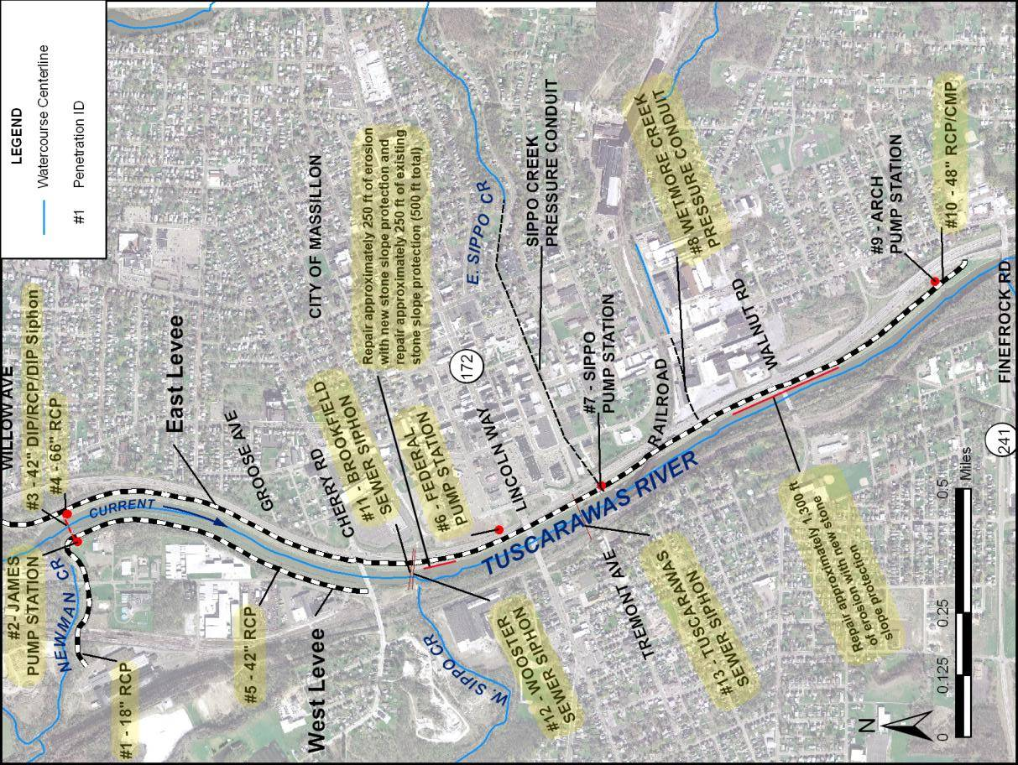
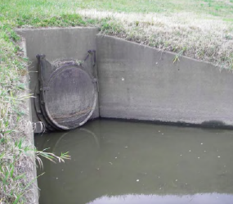
Pipe
Penetrations
(City)

Slide 7
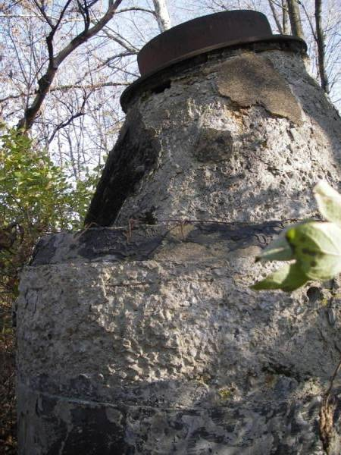
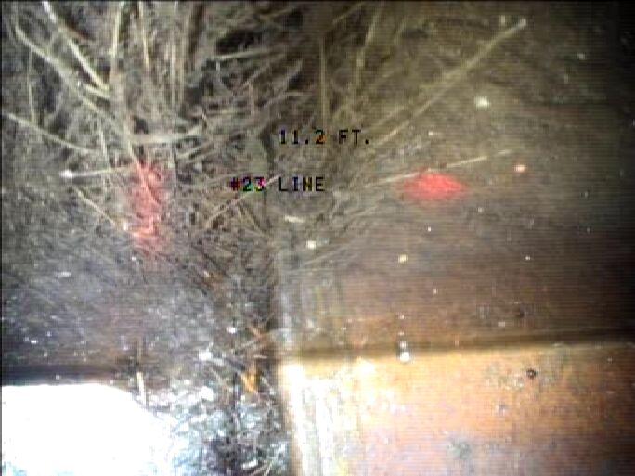
Penetration #1 – West Levee Culvert Along Newman Creek (18” RCP)
Further investigation is required to determine whether replacement or repair of the pipe is appropriate. Replace the existing outlet manhole and install a flap gate for the culvert exit.
Roots exposed at 9 o’clock-11.2 ft
Manhole

Slide 8
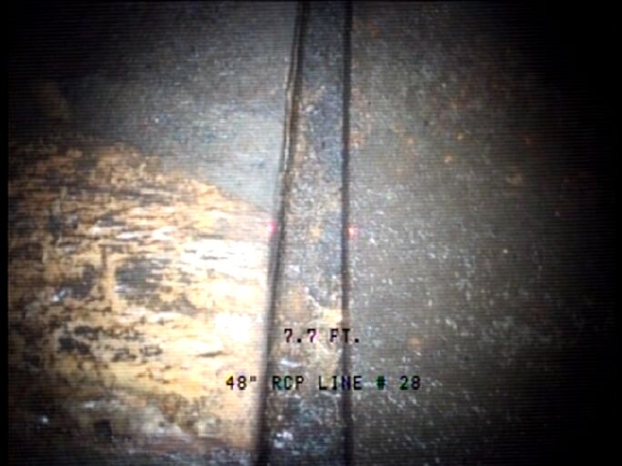
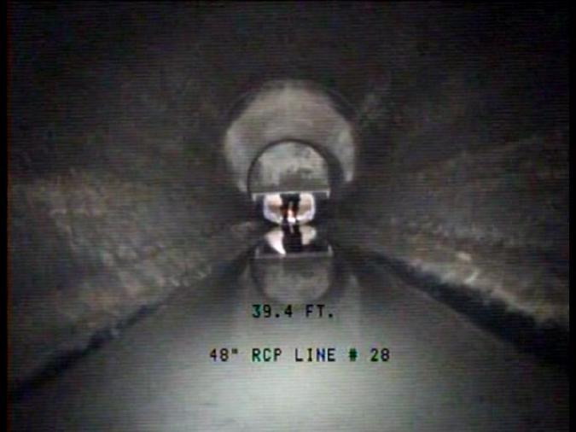
Penetration #2 – James Avenue Pump Station Gravity Drain (48” RCP)
Further investigation is required to determine whether replacement or repair of the pipe is appropriate. The pipe appears to have settled and the joints are leaking.
Approx. 2 in. joint separation at 4 o’clock
Looking at gate from 39.4 ft

Slide 9
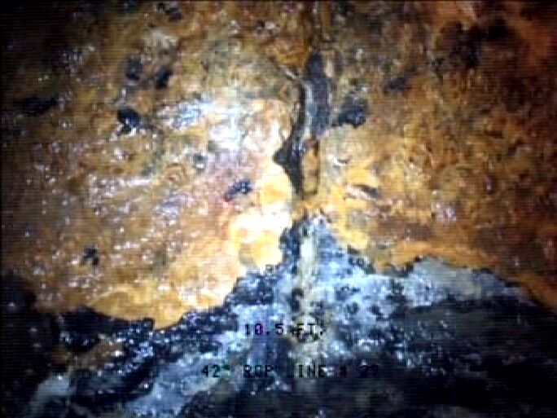
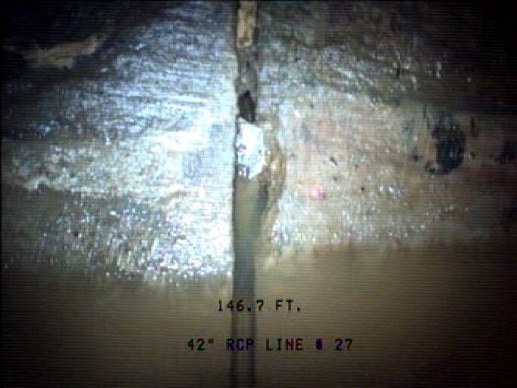
Penetration #3 – Inlet to Control Weir Siphon (42” DIP/RCP/DIP)
Further investigation is required to determine whether replacement or repair of the pipe is appropriate. This pipe is moderately corroded and heavy water infiltration was noted during the video inspection.
Chip out of joint on right haunch
Rusting of pipe wall at joint-10.5 ft

Slide 10
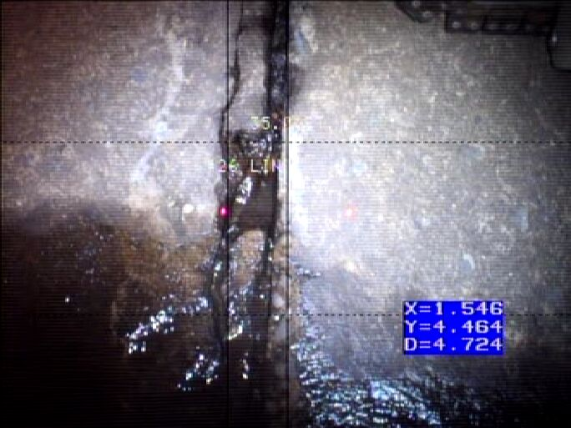
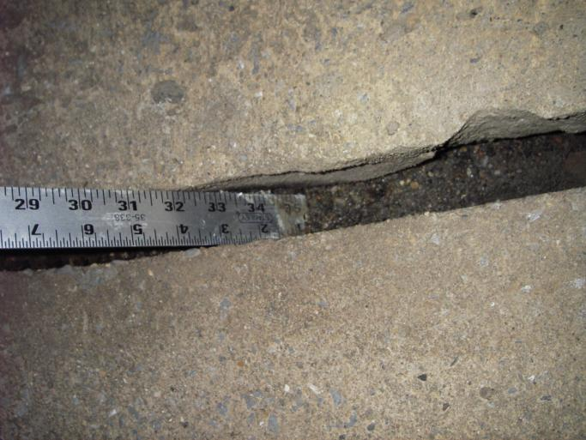
Penetration #4 – East Levee Culvert Near Control Weir (66” RCP)
Further investigation is required to determine whether replacement or repair of the pipe is appropriate. Offset joints, leakage at joints and distress from water moving outside the pipe were observed during video inspection.
1.5 in. joint separation @ 73 ft.
Weeping joint

Slide 11
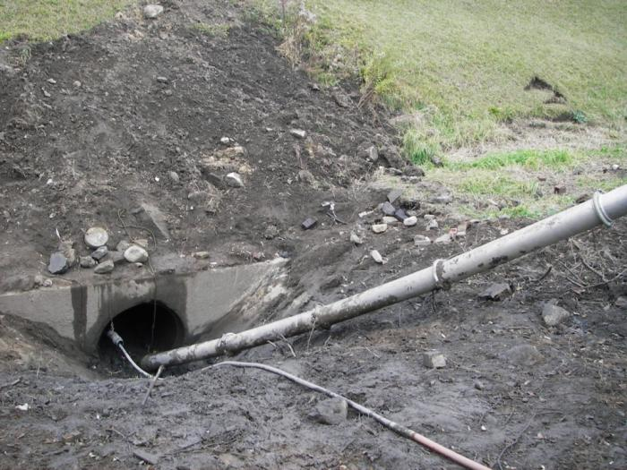
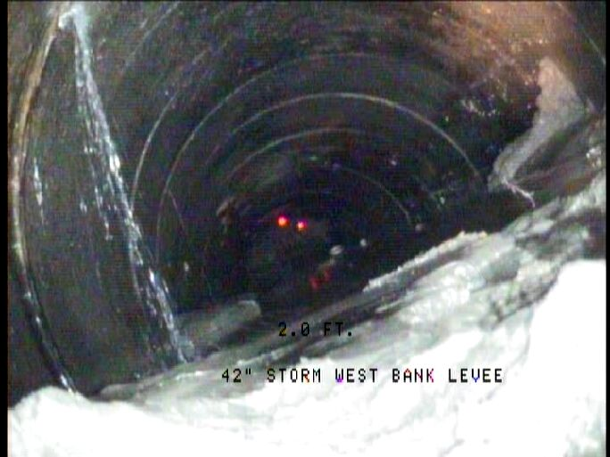
Penetration #5 – West Levee Culvert (42” RCP)
Blockage and siltation of the inlet and outlet should be removed and further investigation conducted to determine whether replacement or repair of the pipe is appropriate. Significant joint leakage was observed at the third joint from the inlet.
Leaking joint (3rd joint from inlet), camera zoomed from inlet.
General Cleaning and TV Photos

Slide 12
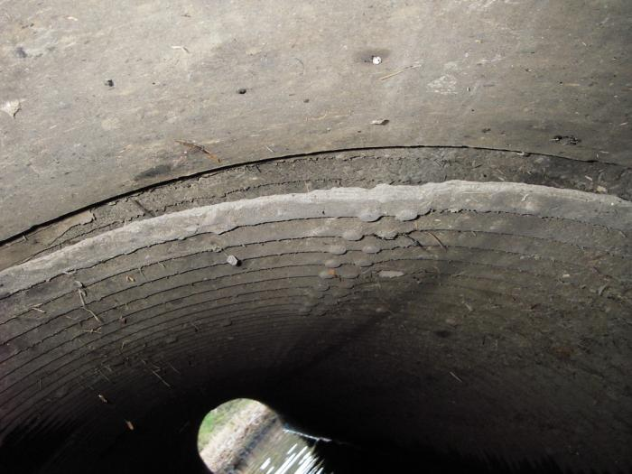
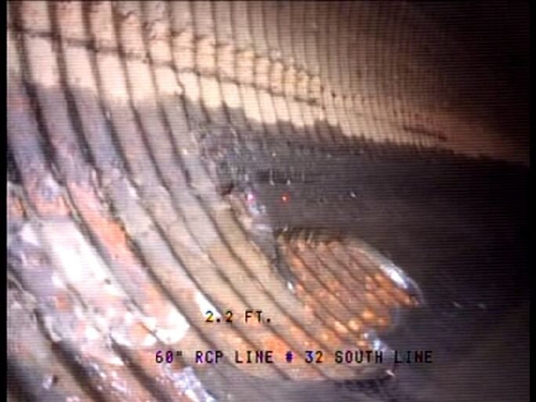
Penetration #6 Federal Avenue Pump Station Outlet (2 – 60” RCP/CMP)
Further investigation is required to determine whether replacement or repair of all or a portion of the pipe is appropriate. The bituminous lining in the invert of the CMP has been eroded along with corrosion. Joint leakage was observed in the RCP section.
Separated joint in crown- 42 ft
Lining at invert of CMP deteriorating

Slide 13
Penetration #8 – Wetmore Creek Pressure Conduit (12’ x 7.75’ RCB)
It appears that replacement is not required; however, a detailed structural inspection should be performed to determine the extent of structural repairs needed. The asphalt lining was eroded leaving large areas of the brick lining exposed to flows. Therefore, the asphalt lining should be replaced.

Slide 14
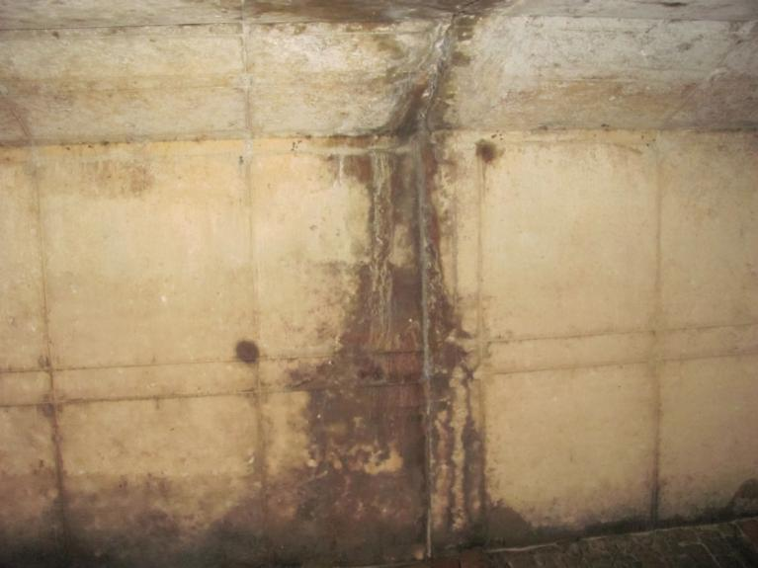
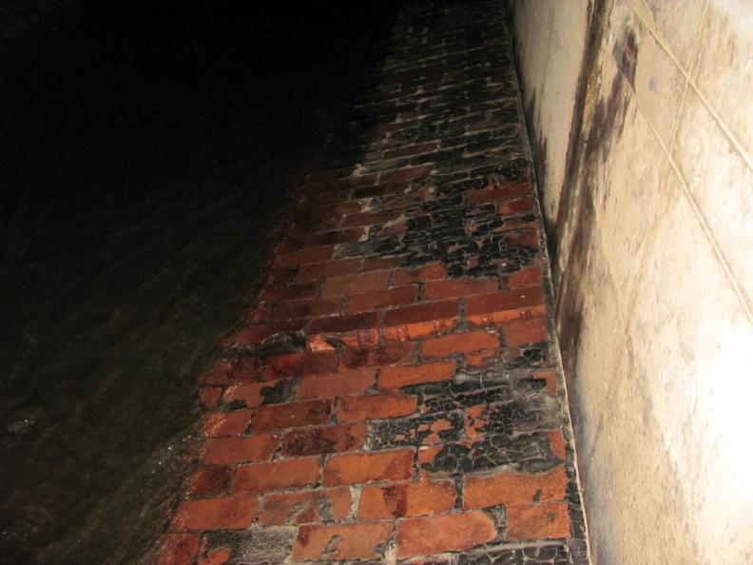
Penetration #8 – Wetmore Creek Pressure Conduit (12’ x 7.75’ RCB)
Weeping vertical wall joint
Eroded asphalt lining exposing the brick floor

Slide 15
Penetration #10 – East Levee Culvert South of Arch Ave (48” RCP/CMP)
Further investigation is required to determine whether replacement or repair of all or a portion of the pipe is appropriate. The CMP section is in the poorest condition with severe corrosion, missing material at the invert and deflection noted. The RCP section shows signs of settlement that may be due to the poor condition of the upstream CMP section.

Slide 16
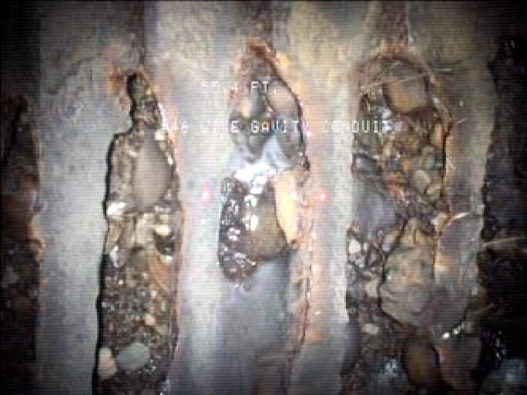
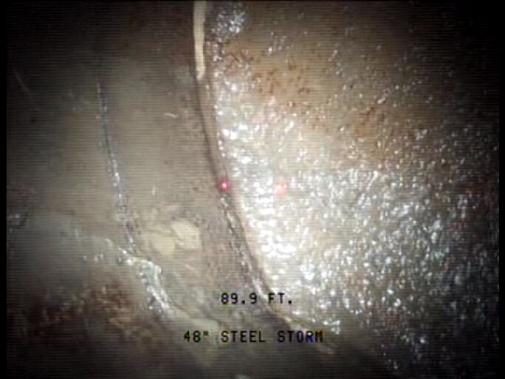
Penetration #10 – East Levee Culvert South of Arch Ave (48” RCP/CMP)
@ 55.4’ Invert rusted out
Water coming in past flap at approx. 7o’clock

Slide 17
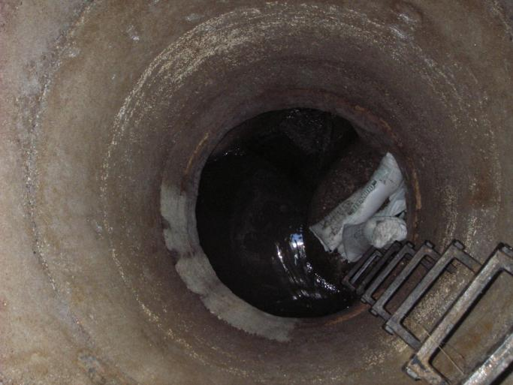
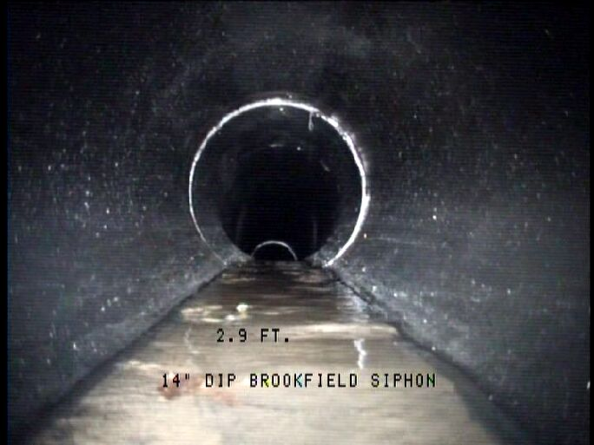
Penetration #11 – Brookfield Sewer Siphon (24”, 14”, & 20” DIP)
Positive cutoffs (gate valves or other cut-off valves) for these siphons were not present and should be installed. The pipes were in “Fair” condition and do not need replaced or repaired at this time.
Flow diversion

Slide 18
Penetration #12 – Wooster Sewer Siphon (18”, 10’ & 15” DIP)
Gate valves for the 10” and 15” pipes were frozen mid position, the gate valve for the 18” pipe was difficult to turn. The 10” and 15” pipes could not be inspected. The 18” pipe was severely corroded above the waterline. Due to the limited inspection and the poor condition of the pipe that was inspected, and the difficulties of maintaining and inspecting the siphons, consideration of replacing the siphon with a pump station should be weighed versus repairing/replacing the siphons. A more detailed engineering analysis should be conducted to determine how to best address these issues.

Slide 19
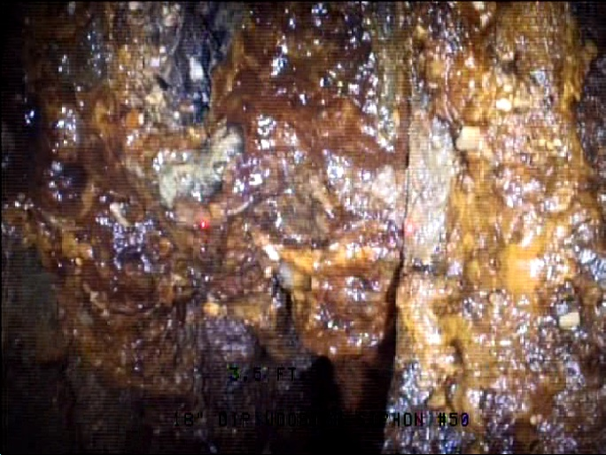
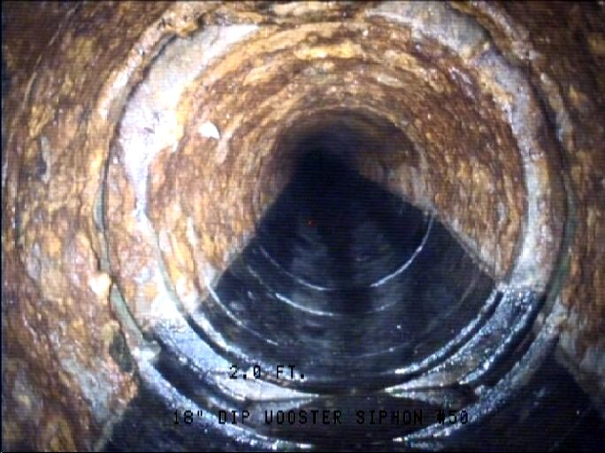
#12 – Wooster Sewer Siphon (18”, 10’ & 15” DIP)
3.5 ft-looking up at corroded gate valve
Broken bell in crown of pipe

Slide 20
Penetration #13 – Tuscarawas Sewer Siphon (8” & 10” VCP)
Gate valves were broken on both pipes and the diversion board on the inlet was rotted through. Metal pipe at gate valves severely corroded. Significant offset/and or debris build up at outlet of the 8” pipe and several offset joints in the 10” pipe were observed. Due to the poor conditions of the pipes and the difficulties of maintaining and inspecting the siphons, consideration of replacing the siphon with a pump station should be weighed versus repairing/replacing the siphons. A more detailed engineering analysis should be conducted to determine how to best address these issues.

Slide 21
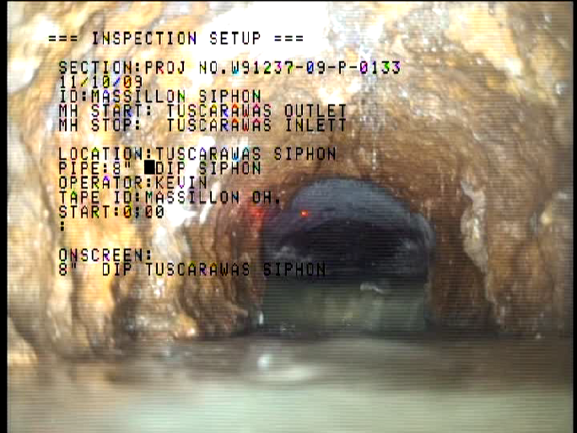
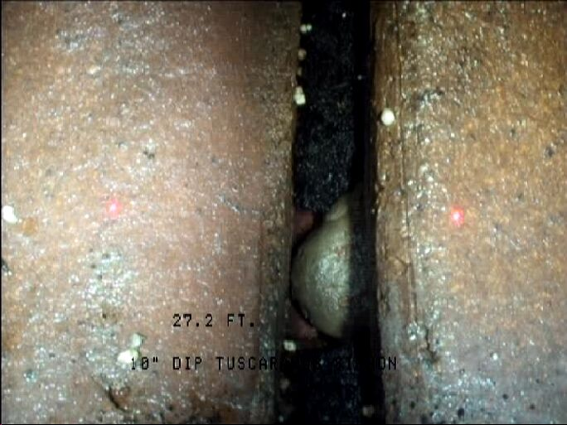
Penetration #13 – Tuscarawas Sewer Siphon (8” & 10” VCP)
Offset joint
Severe offset joint at 8” outlet

Slide 22
Erosion (COE)
East Levee:
  650 feet upstream and downstream of the Walnut Road Bridge.
  250 feet of levee immediately downstream of the existing stone slope protection across from West Sippo Creek.
  Existing stone slope protection across from West Sippo Creek (approximately 250 feet in length) should be repaired and replenished.

Slide 23
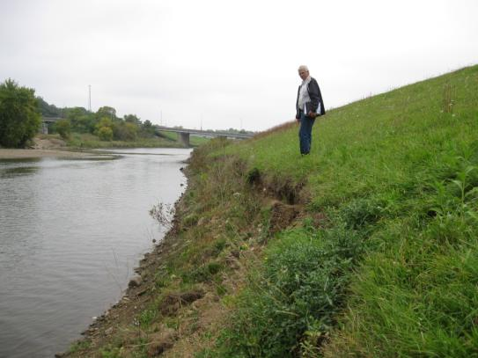
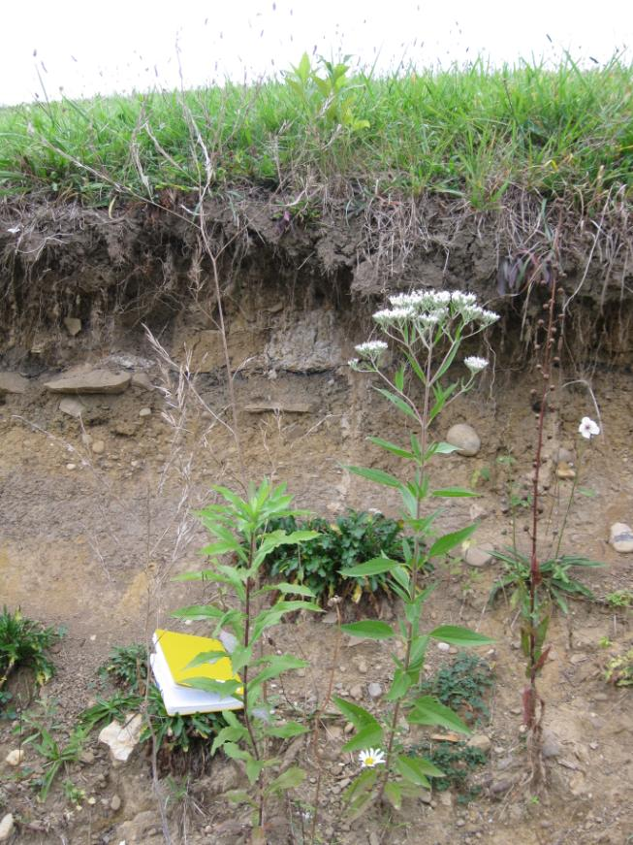
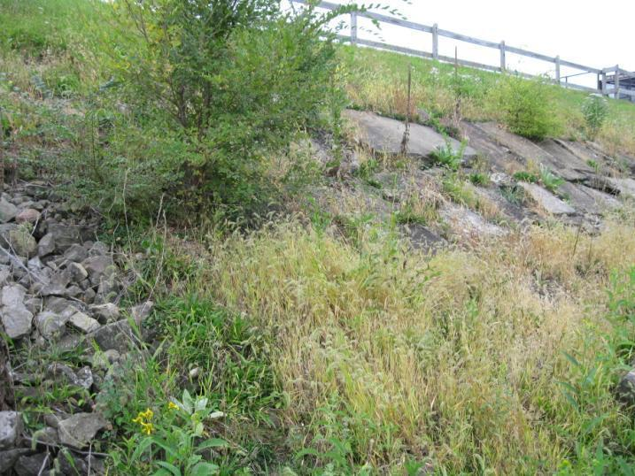
Erosion Photos

Slide 24
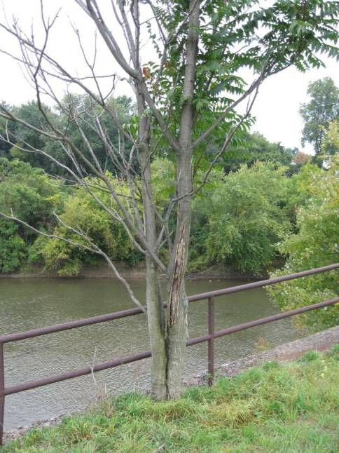
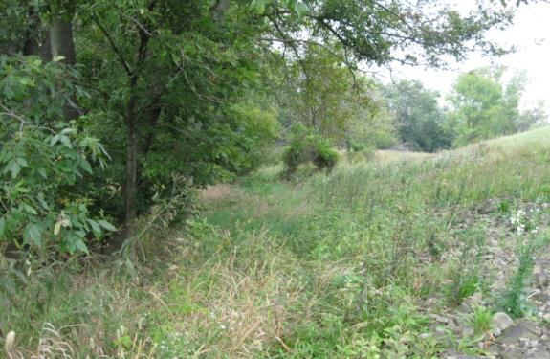
Trees and Vegetation (COE)
Remove trees and vegetation within the 15-foot wide vegetation-free zone of the levee
  Landside of East and West Levees near control weir
  Riverside and landside of upper portion of West Levee
  Riverside of upper portion of East
  Levee

Slide 25
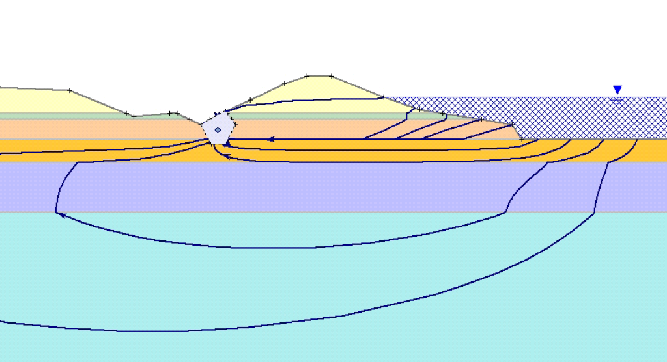
Toe Drain Investigation (COE)
Inspect and verify the condition of the toe drain along the landside toes of the East and West Levees

Slide 26
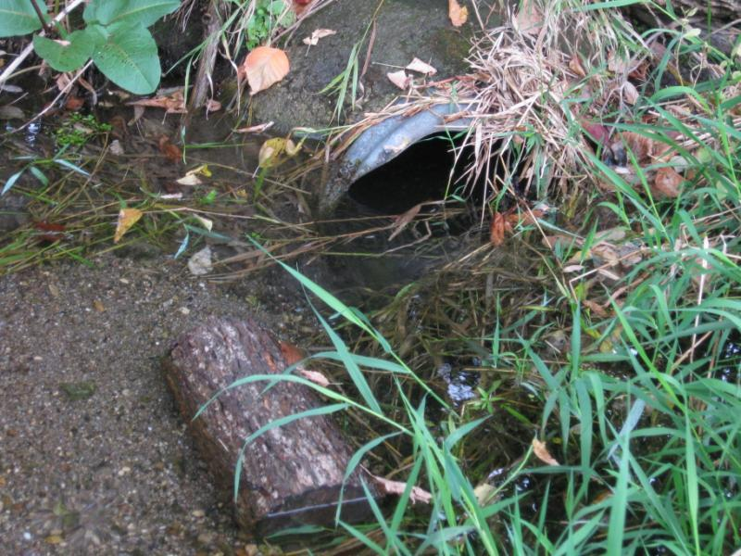
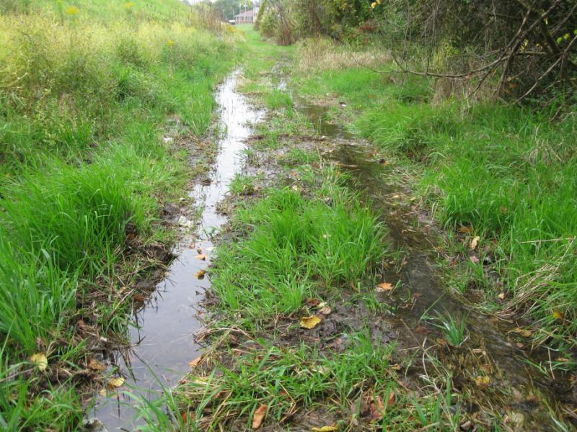
Illegal Drains (City)
Remove/reroute two illegal industrial drains that are discharging water toward the landside toe of the west levee

Slide 27
Minor and Supply/Procurement Issues on West Levee (City)
The following issues on the upper portion of the West Levee (Levee Arm “B”) also need to be addressed prior to levee certification. However, these issues can be addressed with simple repairs or supply procurement.
Replace several warped wooden stop logs at the railroad closure structure
Replace deteriorated sandbags in the storage room
Replace missing ratchet for tightening rods/nuts
Replace missing caulking “Cinders” (about 10 bags required)
Ensure that the metal access door of the storage room can fully open

Slide 28
Questions?

